Slide 1
Leveraging PPP’s to Finance Infrastructure in the ASEAN Region

Slide 2

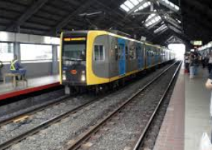
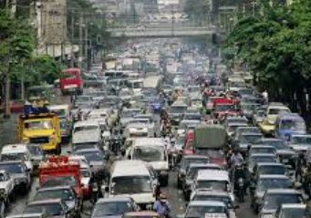
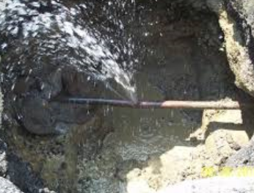
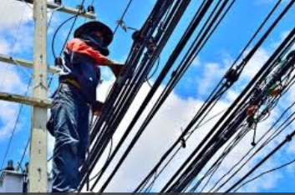

ASEAN Region Faces Growing Infrastructure Needs & Challenges

Slide 3
Many Asian Mega Cities Lack Adequate Mass Transport Infrastructure
Rail distance per 1M population
Stations per 1M population

Slide 4
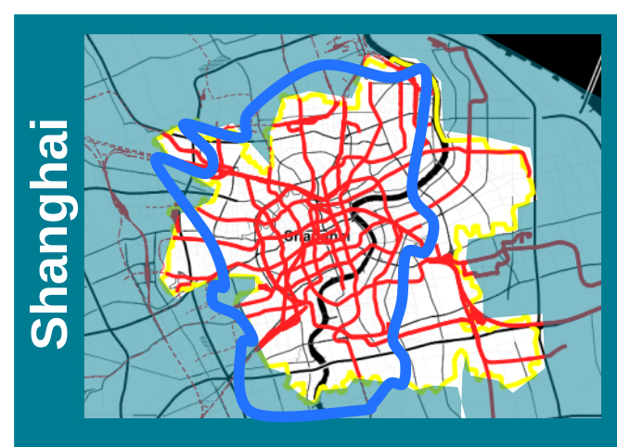
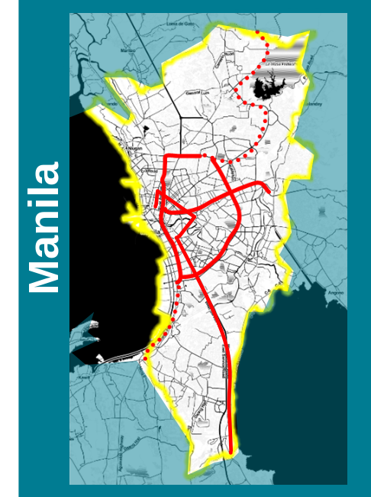
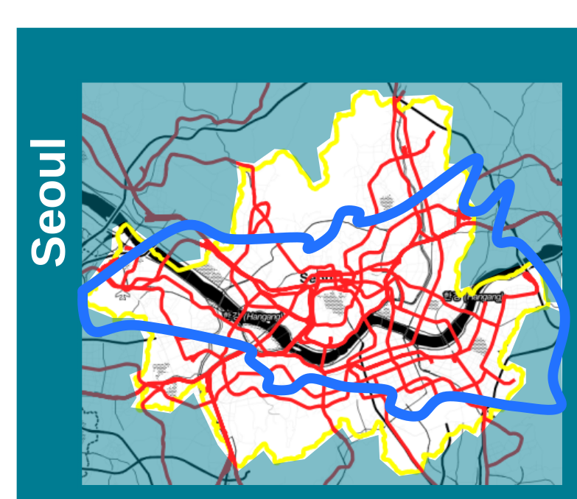
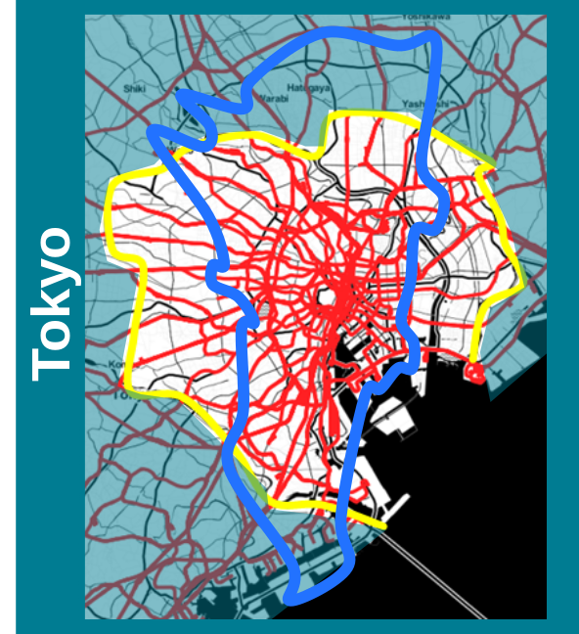
Metro Manila as an Example
NCR comparables | Area (sqkm) | Pop | Density (Pop/sqkm) | Km of rail | Ridership
Manila | 620 | 12M | 19,000 | 85 (+45) incl PNR | 1.3 M
Tokyo | 620 | 9M | 14,000 | 700 | 30 M
Shanghai | 500 | 10M | 20,000 | 590 (+100) | 8.4 M (Metro)
Seoul | 605 | 10M | 16,000 | 390 (+100) | 7.2 M (Metro)

Slide 5

Harnessing the Private Sector through PPPs
  PPPs are a tool to harness private sector capital, expertise and innovation to deliver infrastructure investment needs

Slide 6
What is a PPP?
      P_ _ _ _ _ _ _ _ _ _
      P_ _ _ _ _ _
      P_ _ _ _ _ _ _ _ _ _

Slide 7
What is a PPP?
      Preparation
      Process
      Partnership

Slide 8
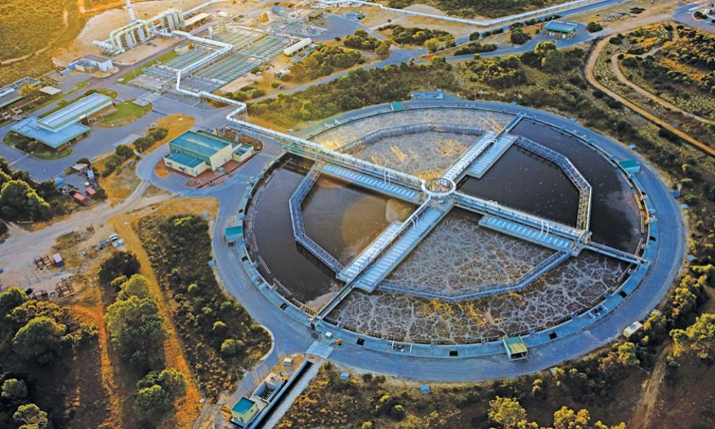
PPP Benefits
Single procurement processes
Stronger incentive framework to minimize construction delays
Single accountability point
Investor responsible for cost overruns, delays and operating performance
Investor responsible for lifecycle costs

Slide 9

PPP Considerations
Stable Public
Policy
Identify Suitable Projects
Conducive Legal & Institutional Environment
Output Based Standards
Market Investment Opportunities
Higher Transaction & Capital Costs
Transparent Process
Contract
Management
Complex & Longer
Preparation
Loss of Control

Slide 10
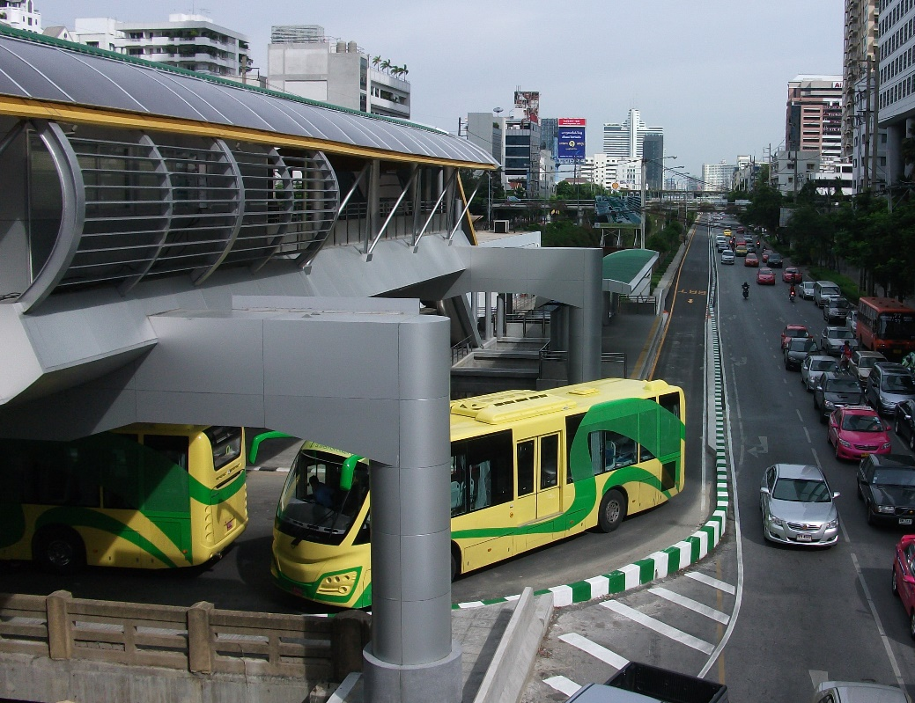
What Makes Bankable PPPs?
IFC’s Perspective

Slide 11




Key PPP Components
CONTRACT DESIGN
PROJECT FINANCING
SERVICE OBLIGATIONS/STANDARDS
SUSTAINABLE RISK ALLOCATION
MONITORING MECHANIMS
DISPUTE RESOLUTION
TENDER PROCESS
SERVICE AFFORDABILITY
BALANCED PAYMENT
SUSTAINABLE & BANKABLE STRUCTURE
INVESTOR FAIR TREATMENT
GLOBAL MARKETING
TRANSPARENT TENDER & EVALUATION CRITERIA

Slide 12
Bankability Requirements
Appropriate pricing to enable adequate debt service coverage and equity returns
Appropriate risk allocation and mitigation
Transparent procurement
Legal and regulatory certainty
Long-term demand projections
Macro-economic stability
Country’s debt capacity
Appropriate credit enhancement if necessary

Slide 13
Risk Allocation Principles
Risks should be borne by the party that can mitigate them
  Rationale: That party can bear the risks at the least cost → overall lower price for the service offered
Problems at the risk allocation stage can delay project negotiations and financial closing
  Several examples of project negotiations 5 to 10 years
Even if projects close in exuberant market sentiment problems down the road in long-term concessions
Risks not mitigated properly are borne by the consumer
  higher tariffs; potential renegotiation and/or contract/service failure

Slide 14
Bankability Principles
Lenders’ requirements are key
Debt provides 60%-80% of project funding and typically follow a limited recourse project finance structure
Project finance lenders rely only on cash flows of the project and not on sponsor’s balance sheet
Sponsors will not use their own balance sheets for large projects in emerging markets (especially over $100m or so) and will require significant debt financing to limit equity risk

Slide 15
Risk Allocation and Mitigation
Risk | Party bearing risk | Rationale / Mitigation
Construction | Private (occasionally both) | Fixed price turnkey EPC contract Liquidated damages for delay and performance
Financing | Private | Financing bond
Operating | Private | Penalties, operations security, O&M contractor
Demand | Depends on type of project | Single buyer electricity / water offtaker: Government takes the risk Airport concession: private sector (may include exclusivity provisions) Toll road: risk may be shared through minimum traffic guarantees, “shadow tolling” or annuity
Payment | Depends on type of project | Same as above. Payment obligations of SOEs (eg water and power offtakers) may need a government guarantee and PRG/MIGA/PRI cover

Slide 16
Risk Allocation and Mitigation
Risk | Party bearing risk | Rationale / Mitigation
Macro-economic: inflation | Built into tariff / user charges | Single buyer: tariff indexation Airport, toll roads, distcos: indexation of regulated user charges
Macro-economic: FX rates | Built into tariff / user charges (if FX financing) | Single buyer: tariff indexation Airport, toll roads, distcos: indexation of regulated user charges
FX availability | Government | If project revenues are in a “soft” currency, Gov covers this risk
Political, regulatory | Government | In less mature markets, assurances from Government, Governmental Force Majeure and “change in law” provisions are common

Slide 17
Risk Allocation and Mitigation
Risk | Party bearing risk | Rationale / Mitigation
Natural force majeure affecting private party | Private sector | Commercial insurance → reinsurance Some retention
Natural force majeure affecting public party | Public party | Commercial insurance Mostly retention
Project specific: Fuel supply | Could be either | Borne by public party if fuel supply is state-controlled
Project specific: Hydrology | Could be either or shared | If reliable long-term data exist, private sector may be willing to take the risk (priced in)

Slide 18
Other Contractual Provisions
Issue | Considerations
Refinancing | Are project revenues based on contractual tariffs based on certain debt assumptions? Long-term debt availability vs. mini-perms
Lenders’ step-in rights | Required for project finance Direct Agreement between government / offtaker, sponsors and lenders
Dispute Resolution | Local vs. international Arbitration venues
Governing Law | Local vs. international
Contract rebalancing | May be appropriate under certain circumstances
Termination Payments | For sponsor default For Government / SOE default or PFM events For natural force majeure events

Slide 19
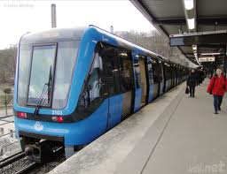
Example ASEAN PPP’s
Manila LRT1, Myingyan IPP & Yangon Expressway

Slide 20
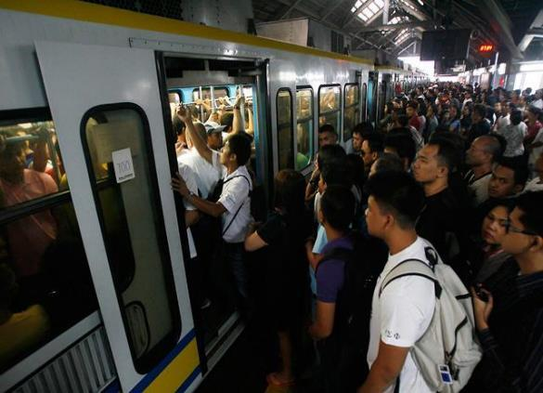
Manila: LRT 1 Extension (2014)
32-year concession to rehabilitate, extend, operate, and transfer
Awarded to a local consortium of Ayala, Metro Pacific Investments with Macquarie; Metro Paris as operator
1 million passengers daily with improved access to services.
$924 million in private investments.
$312 million premium paid to government.

Slide 21
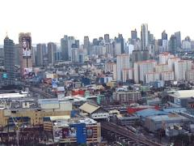
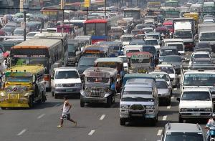

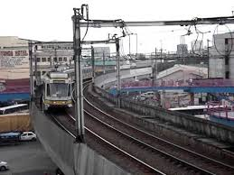
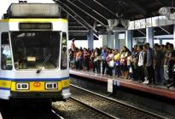
General Facts
Metro Manila:
16 cities and 1 municipality
Population (2010 census): 25 million
Area: 640 sq.km.
Density: ca. 2,000 per sq. km.
LRT1:
Operational since 1984
Fully elevated 20-km guideway
20 stations
Average daily ridership 500,000+ pax/day
Farebox ratio 1.26

Slide 22
LRT1 Cavite Extension PPP – Project Scope
Government Counterparts
Department of Transportation – main line government agency
Light Rail Transit Authority– owner/operator of existing assets
Project Scope
32 year concession
Operations and management of the existing LRT1
Financing, construction, commissioning and operation of an 11-km extension to Cavite, a province south of Metro Manila.
Project Cost (Government Estimate)
Civil & Electromechanical Works for the Extension: US$925 mln (private)
Additional New Trains and ROW: US$575 million (public)
Government capital grant of up to US$112mln (bid parameter)

Slide 23
LRT1 PPP – Key Risk Allocation
Risk | Private Concessionaire | Public (DOTC & LRTA)
Existing Assets condition on turnover |  | ✓
Financing – Extension & Rehab | ✓
Financing – ROW & Add Trains |  | ✓
Demand/Ridership | ✓
Design & Construction | ✓
ROW |  | ✓
Operations | ✓
Fare setting (shadow fare) |  | ✓
Maintenance | ✓
Taxes | ✓
Force Majeure | ✓ | ✓
*Shadow Fare – the Concession Agreement included a shadow fare in the event Gov did not implement planned fare increase

Slide 24
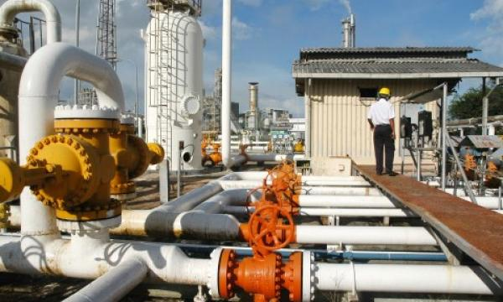
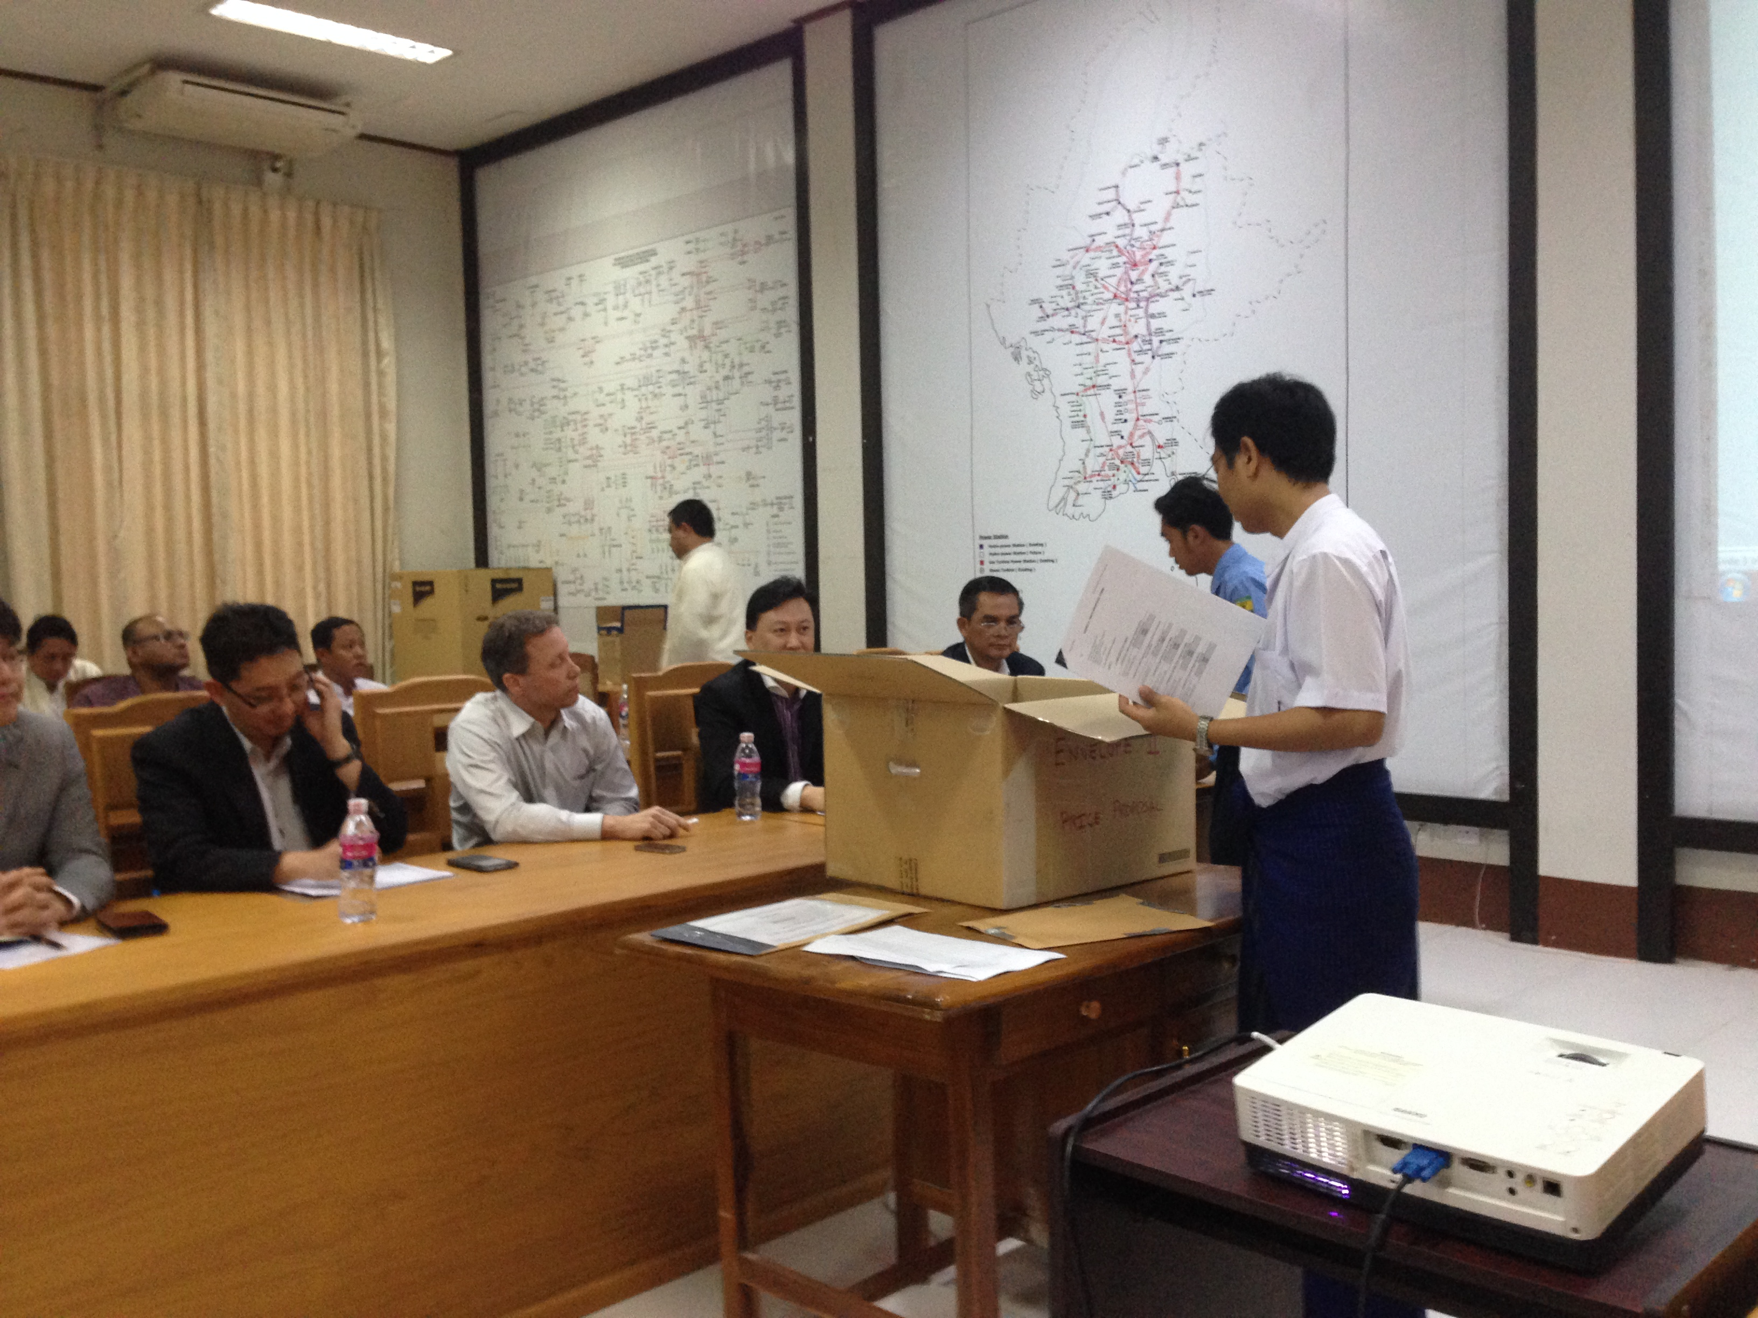
Myingyan IPP Project
Competitive Tender Process Created Value for Myanmar
  IFC was lead transaction advisor to MOEE for the PPP
  First independent power producer (IPP) project in Myanmar
  16 major international companies participated in the tender process

Slide 25
Background
  Myanmar was facing acute power shortages and has a very low electrification ratio (about 30%)
  Government opened power generation sector to private investors in 2012-13
  225 MW Myingyan IPP is the first competitively tendered project in the power sector
  IFC was appointed as Transaction Advisor to GoM in 2014 to advise on project preparation and implementing a transparent and competitive tender

Slide 26
Key Bankability Issues
  New and untested market for IPPs and PPPs in general
  Creditworthiness of utility off-taker
  Lack of government guarantee framework
  Enforcement of international arbitral awards

Slide 27
Result: Competitive Bidding Process for Myingyan IPP Resulted in Large Cost Savings for Myanmar
 | Rank | Difference in price from Rank 1 (in US cents/kWh) | Annual increase in Gov payments ($ mill) | Over 22 year term ($ mill)
Bidder A | 1
Bidder B | 2 | 0.4650 | 7.9 | 173
Bidder C | 3 | 0.4869 | 8.2 | 182
Bidder D | 4 | 0.7188 | 12.2 | 268
Bidder E | 5 | 1.2442 | 21.1 | 464

Slide 28
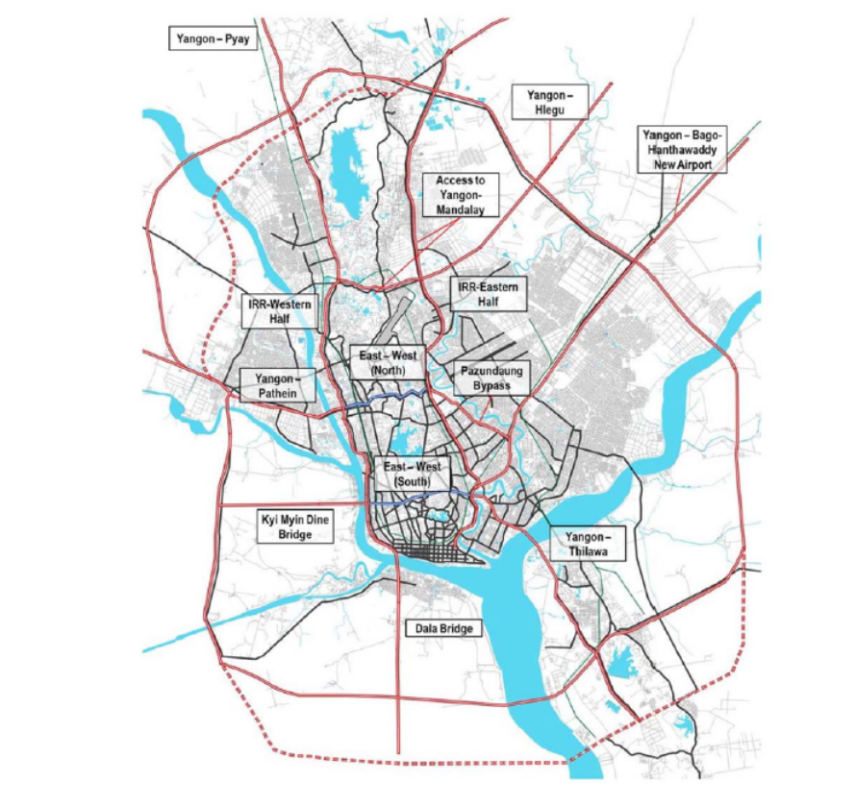
Yangon Expressway Network
Network of expressways for Yangon proposed to be implemented over the coming decades
Comprised of an inner ring road (elevated), outer ring road (at grade) and radial spokes
Inner Ring
Outer Ring

Slide 29
Inner Ring Road Expressway
Inner ring road is comprised of three elevated sections, likely to be built in phases:
East Wing (25km)
East-West Wing (6km)
West Wing (16.5km)

Slide 30
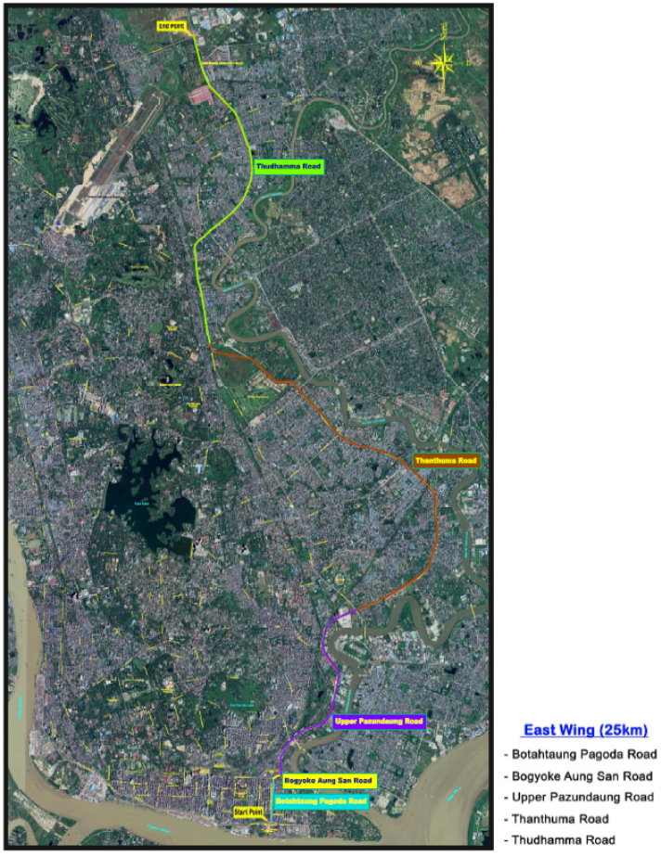
Phase 1 – Yangon Elevated Expressway
Yangon Elevated Expressway Project, sponsored by the Ministry of Construction (MoC), is one of the priority projects of the Union Government of Myanmar( GoM)
Project is one component of the Yangon Urban Expressway System that is intended to provide a high-standard expressway
Phase 1 - East Wing: 25km 4-lane elevated expressway
Built on viaduct along existing roads
Under analysis:
  Number and location of on/off ramps and toll booths
  Tolling structure and technology
  Financing structure

Slide 31
Investment Opportunity
MoC will be the direct counterparty in the Concession Agreement (CA)
Term of CA is expected to be 30 years
Traffic demand forecast and willingness to pay study will be conducted to determine toll revenue projection

Slide 32
Scope of PPP Project – Private Investor
Preparation of a Detailed Engineering Design in accordance with specifications defined in the CA
Construction of the elevated expressway including all on/off ramps
Provision of toll plazas, safety facilities and other systems
Operation and Maintenance of the Expressway as a tolled expressway.

Slide 33
Government Support
MoC is committed to conduct of a fully transparent and competitive procurement process in line with best practice
MoC will provide Right of Way (RoW) for the project
GoM will provided a Sovereign Guarantee of MoC obligations under the Concession Agreement
Various forms of Government financial support will be analyzed and considered for the project

Slide 34
Conclusion

Slide 35
Conclusion
PPPs can be a tool to deliver needed investment in infrastructure & services in ASEAN region
PPP will not create a financially viable project when project is intrinsically financially unviable
Lenders typically provide up to 80% of the financing for PPPs – risk allocation and process needs to comply with their requirements
Due to lack of success of many demand-risk PPP projects in previous years, many projects are now procured on an availability basis
Proper preparation and design are keys to facilitating successful PPP projects

Slide 36
THANK YOU
www.ifc.org/ppp
  John Leber
  Investment Officer
  IFC Public Private Partnerships Transaction Advisory Services
  Tel: +632.465.2721
  Mob: +639.277.929.554 (Manila) / +1.240.425.2455 (US)
  E-mail: jleber@ifc.org
  Website: www.ifc.org/ppp
  © IFC 2018

