Slide 1


ASEAN PPP
SUMMIT
Illustrating PPP with example in Waste Management

Slide 2





supporting
major societal revolutions since 1858
THE TRADE
REVOLUTION
THE HYGIENE
& PUBLIC HEALTH
REVOLUTION
THE URBAN
COMFORT
REVOLUTION
THE
RESOURCE
REVOLUTION
SUEZ canal inauguration
The industrial revolution leads to the development of cities in need of infrastructure for the sake of people’s’ hygiene and health: Water and sanitation networks are built over great distances, access to safe water is provided, and modern waste collection is invented.
After the war, big cities and suburbs increase their needs in water supply demand to provide a healthy water 24/7 for more people, to treat urban and industrial waste water, to collect but also store and incinerate increasing waste quantities.
At the dawn of the 21st century,
a new chapter begins at the Rio Earth Summit.
World leaders make the protection of the earth a priority.
Cities and industries are seeking new solutions to face resource scarcity.
1858-1869
1880
1945
1990
Today

Slide 3

employees
over 90,000
operating on
5 continents
industrial and business
customers
over
450,000
turnover in 2016*
€15.3
billion
SUEZ,
SUEZ
activities
at a glance
A world leader in the smart and sustainable management
of resources,
we help cities and industries optimize water management, recycling and waste recovery.
drinking water produced (worldwide)*
5.3 billion
cubic meters
drinking water distributed
(worldwide)*
3,162 million cubic meters
waste water recycled
(worldwide)*
882 million cubic meters
wastewater depolluted
(worldwide)*
92%
people benefiting
from waste collection services*
34 million
people
waste treated*
41 million
tonnes
hazardous waste treated*
2.9 million
tonnes
recovered material from sorting centers*
10.4 million tonnes
consolidated figures including GE Water & Process Technologies as of December 31, 2016
*data as of 31/12/2016 without GE Water
Notes:
Suez et veolia = 50% of PPP in the world in water.

Slide 4
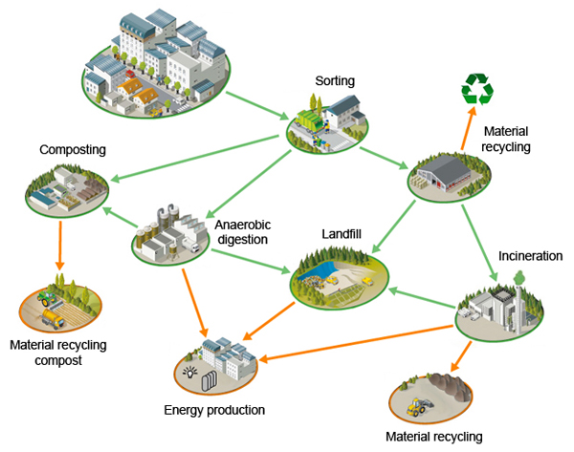
PPP a tool to support
Complexity of the Waste Management and Treatment Process
Notes:
So many activities – how can one player to do !

Slide 5

Why Public Authorities need PPPs in Waste Management
Performance Drivers
Improve the Quality waste management of the Services
Limited capacity for efficient management and innovation which results in risks.
Governance Drivers
Identify a responsible body with precise duties and charges
Transparency.
Economical Drivers
Discrepancy between limited revenues and strong financing needs
Including a private partner increases the credibility of their loan demands
Difficulties in getting access to international finance .
Environmental and Social Drivers
Infrastructure in need of capital improvements to meet environmental compliance issues
Difficulty in complying with regulatory standards..

Slide 6
Private Sector Involvement
Value creation for the client
Contractor’s risk / revenue
Privatization
Full Utility
Concession contract*
Range of
Lease / affermage
contract
Contracts
to improve
clients
performance
BOT / DBFO /
PFI contracts
Legend:
Infrastructure
DBO contract
Service
contracts
Partial Utility =>
Operation & Maintenance (O&M)contract
Infrastructure contracts
Public Utility =>
Management contract
Consulting engineering
<= Support
Technical assistance
Consulting
Public-Private Partnership (PPP)
Asset ownership
Increasing PP/operator’s time commitment and / or suitable context for PPP

Slide 7
The contracting model should match the main clients drives
Objective drivers
What is the Objective of the Client?
Technical and management skills?
Operational Efficiency ?
Increase private investment ?
Construction optimization?
Responsibility Drivers
What part of the responsibility is the client ready to delegate?
Scope of work Drivers
Which duration does the client want to be engaged?
Which level of risk does the client want to transfer?
Does the client have human resources to allocate for the project
What is his level of technical capacity ?
Financial resource Drivers
What part of investment can the client bring
What finance benefit is the client expecting

Slide 8
 | Client’s objectives
Contract models | Benefit from technical and management skills | Improve operational efficiency | Increase private investment | Outsource construction to operator/PP
Management contract | Yes | Possibly | No | No
O&M | Yes | Yes | No | No
DBO | Yes | Yes | (No) | Yes
BOT/DBFO/PFI | Yes | Yes | Yes | Yes
Affermage/Lease | Yes | Yes | Possibly | No
Concession | Yes | Yes | Yes | Yes
Increasing Private Partner’s responsibilities
Which
Contract
Depending on
Objective driver
Waste Management Activity | Type of contract
Collection/Street cleaning | Concession
Recycling | DBO/O&M
Landfill | DBO/O&M
WTE / MBT or other treatment | DBO/BOT/O&M
Notes:
SLIDE DIGITAL – slide à venir SMART
Fostering the digital innovation
1. Acquisition
2. Innovation
3. Key figures
A changing market (2/3 key figures)
1. Key figures (en 2017, il y a plus d’obj connecté que d’être humain) / le marhé des techno inteliggente dans l’eau va croite de 50% dans les 50 années
2. SUEZ : how we innovate (le digital transforme le marché) –
// en digit, real-time monitoring and performance : XX – 3 million de capteurs / Resource management real-time
Bénéfice, la plateforme organix, connecting ceuw qui produisent les déchets et ceux qui en font les resources
Optimizing the performance
3. Accelerating through key acquisition : Rubicon (waste) / lancement d’organix
Comemnt on innove grâce à Insight?
Visio: là ou ya l’œil
Enabl epublic officials to monitor their

Slide 9
BOT : Transferring Risk to the private sector
Availability Risk | The risk that the quantum of service provided is less than required under the contract
Construction Risk | The risk that the construction of the physical asset is not completed on time, to budget and to specification
Demand Risk | The risk that demand for the service does not match the levels planned, projected or assumed
Design Risk | The risk that de design cannot deliver the services at the required performance or quality standards
Inflation Risk | The risk that actual inflation differs from assumed inflation rates
Legislative Risk | The risk that change in legislation increase costs. This can be sub-divided into general risks such as changes in corporate tax rates and specific ones
Maintenance Risk | The risk that the costs of keeping the asset in good condition vary from the budget
Operational Risk | The risk that operating costs vary from budget, that the performances standards slip or the service cannot be provided
Planning Risk | The risk that the implementation of project fails to achieve the terms of planning permission, or that detailed planning permission cannot be obtained, or I obtained, can only be implemented at costs greater than the original budget
Residual Value Risk | The risk relating to the uncertainty of the value of physical asset at the end of the contract period
Technology Risk | The risk that changes in technology result in services being provided using non optimal technology
… | …
SUEZ,

Slide 10
Guarantee by the Public Party
Provide Land
Definition of the Waste ( MSW , Food Waste , C&I)
Guarantee of minimum Waste Volume ( ex : 1000 TPD)
Payment Guarantee
Terms of contract ( 20 years..)
Risk by the Public Party
Demand Risk
Change of Law
Risk of Choosing …
BOT
Risk and Guarantees
Example of WTE
Guarantee By the Private Party
Time to completion
Fixed Gate Fee ( with inflation revision)
Waste Volume swallowing capacity ( ex : 1000 TPD)
Truck turn around time ( ex 20 min)
Environmental compliance (Emissions to Air , Effluent)
Community Management
Risk taken by the Private Party
Construction risk and project Schedule
Fixed Gate Fee
  O&M Cost
  Waste Calorific Value which influence electricity production
Availability Waste Volume swallowing capacity ( ex : 1000 TPD)
Environmental compliance ( design risk , Operation Risk)
Safety Risk , Community risk
Notes:
SLIDE DIGITAL – slide à venir SMART
Fostering the digital innovation
1. Acquisition
2. Innovation
3. Key figures
A changing market (2/3 key figures)
1. Key figures (en 2017, il y a plus d’obj connecté que d’être humain) / le marhé des techno inteliggente dans l’eau va croite de 50% dans les 50 années
2. SUEZ : how we innovate (le digital transforme le marché) –
// en digit, real-time monitoring and performance : XX – 3 million de capteurs / Resource management real-time
Bénéfice, la plateforme organix, connecting ceuw qui produisent les déchets et ceux qui en font les resources
Optimizing the performance
3. Accelerating through key acquisition : Rubicon (waste) / lancement d’organix
Comemnt on innove grâce à Insight?
Visio: là ou ya l’œil
Enabl epublic officials to monitor their

Slide 11
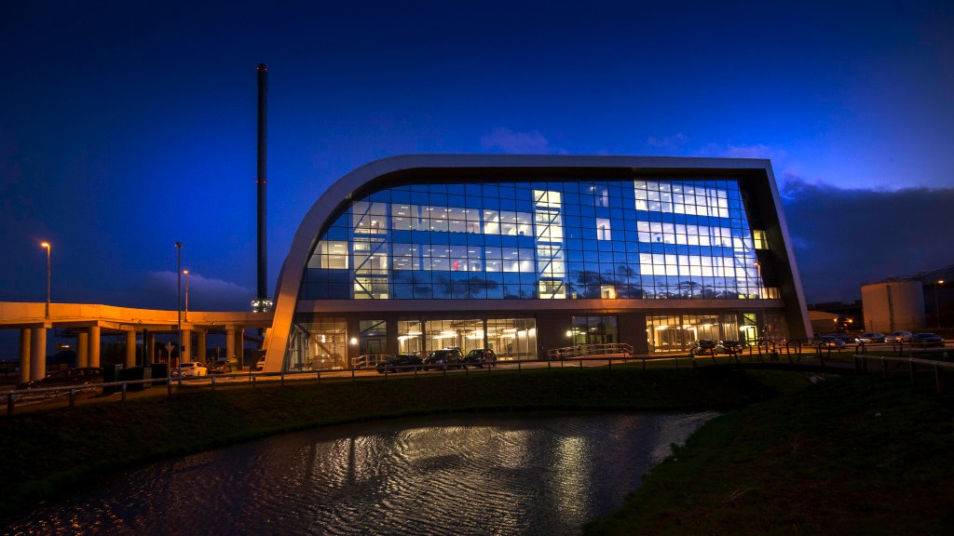

Example of PPP
improving economic and environmental performance

Slide 12

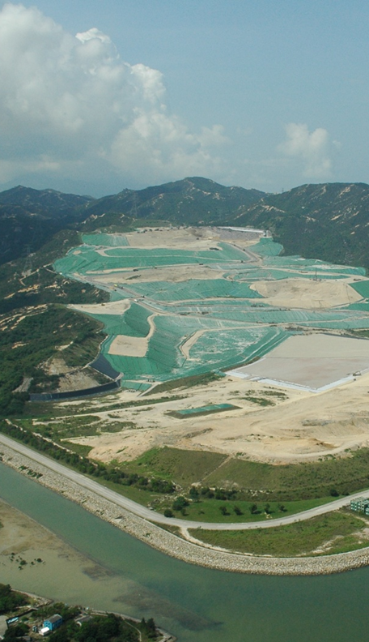
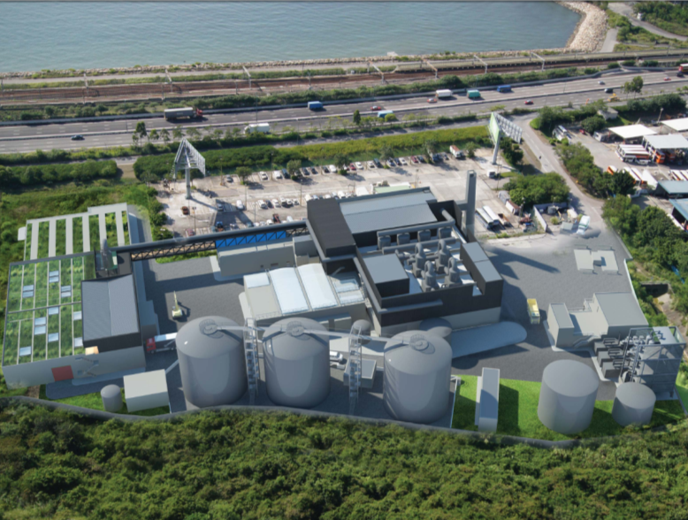
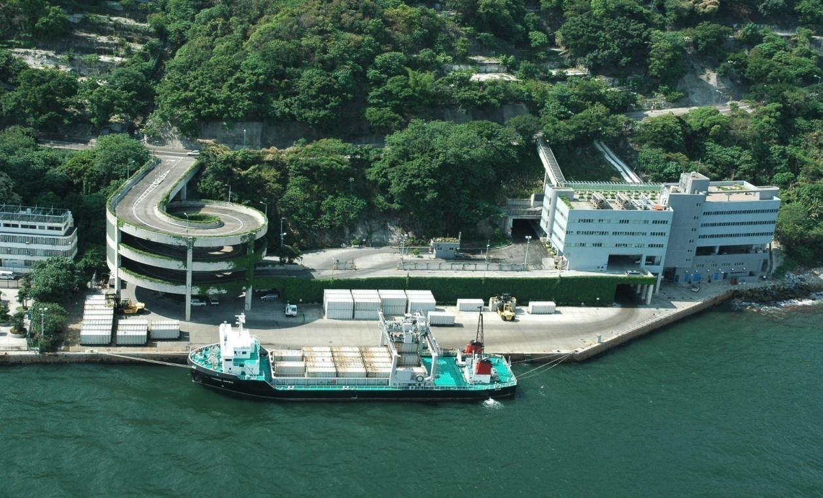
<< BACK
Hong Kong
The land of DBO
All Waste management contract in HK are DBO
Landfill , Transfer Station , Infrastructure of Treatment …
Each project are tender separately by EPD ( Environment protection bureau) and consist of Design, Construction and then operation and management contract which terms vary depending on the project.
Benefits for HK
Private Parties design the project based on concept from EPD , no interface between construction and O&M
Allow deployment of technology at low risk
Private Parties in control of the operation with stringent guarantee
Competitivity ( Lower Gate Fee) as :
  Low cost of operation as Asset financing and shareholder return is not part of the services fee.
  Operators is incentivize both on the construction and long term O&M

Slide 13
<< BACK
BOT in South East Asia for WTE
A Challenging Environment
Why BOT
Municipalities in SEA are looking at BOT as Capex for WTE is substantial and they have many others infrastructure project in development.
Technology and Operation are complex , it’s allow the most secure risk allocation of the public party to the private party
The Challenges
Complex Legal Framework with several agencies involve and most of the time not cooperating with each other ( Grid, Cities, Environment bureau..)
Difficult for non-capital cities to interact at national level to ensure that the city follow all the necessary step to get PPP Approve.
Stability of government decision and legal enforcement of contract.
Under-estimation of the need for government guarantee and the impact of Finance industry
Poor conception of project , wrong consultant ( or not independent) pushing for non-proven technology . Misunderstanding of the driver
Conflict inside the public party
Transparency
Management of tender
Barrier to limit competition ( language, ownership …)
Decision making..

Slide 14
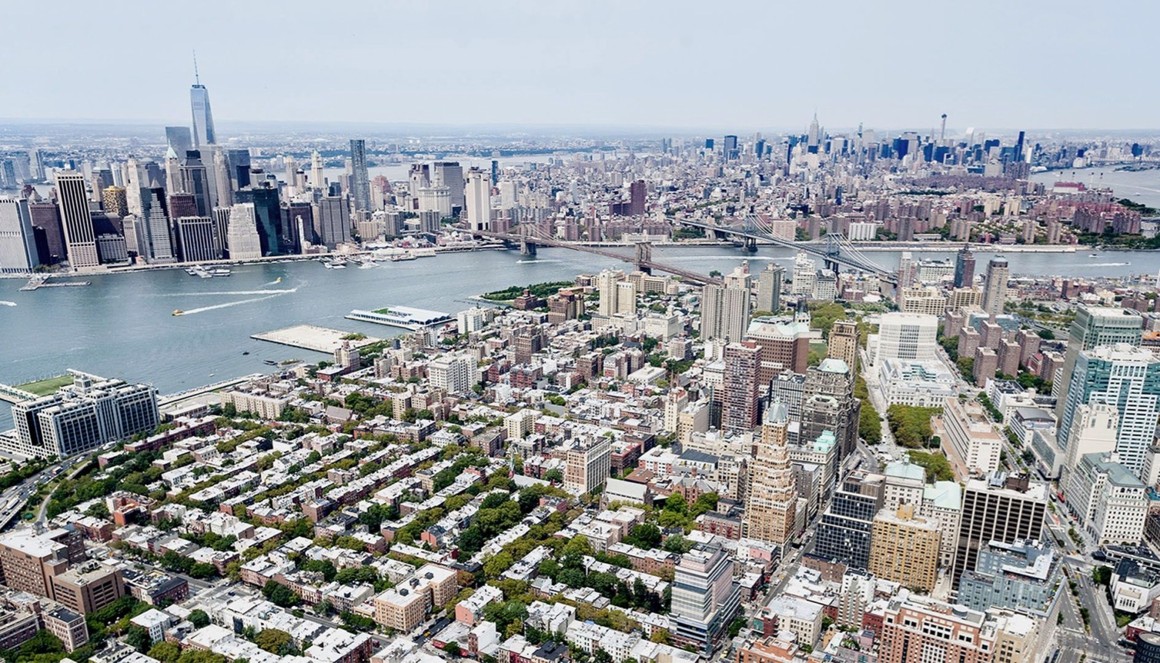
PPP , the future
in smart and sustainable
management of resources

Slide 15

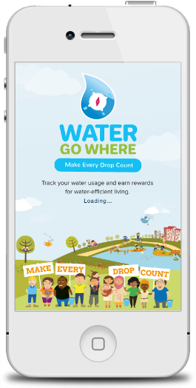
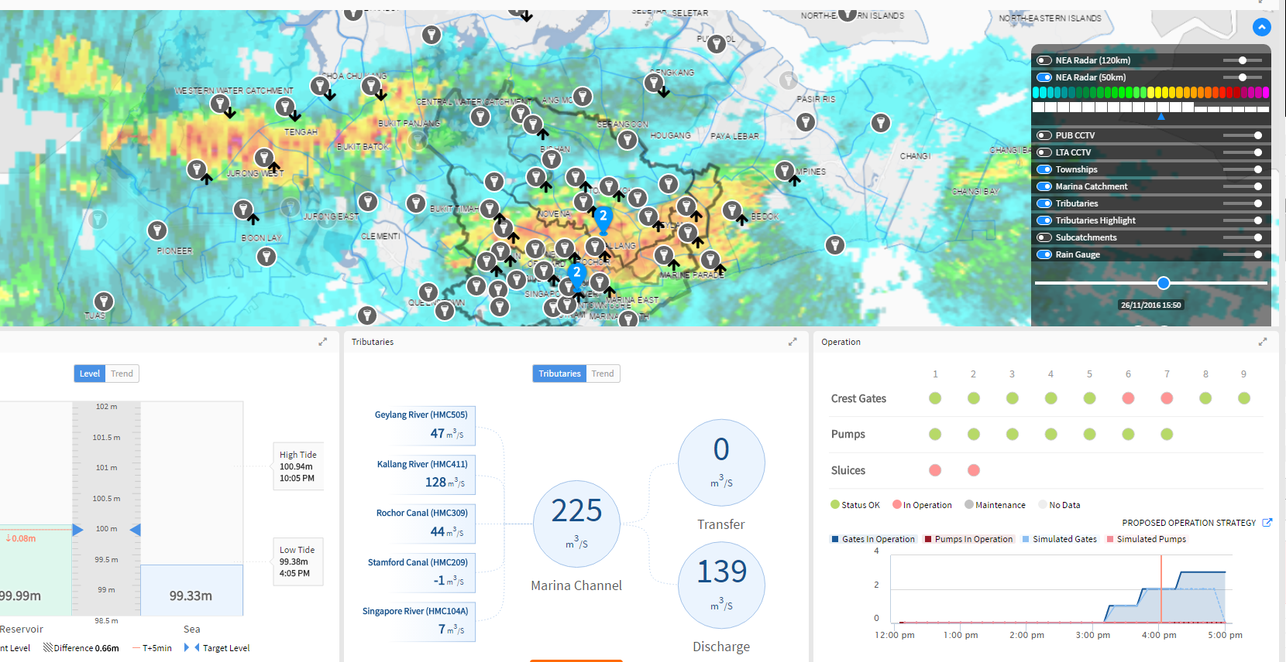
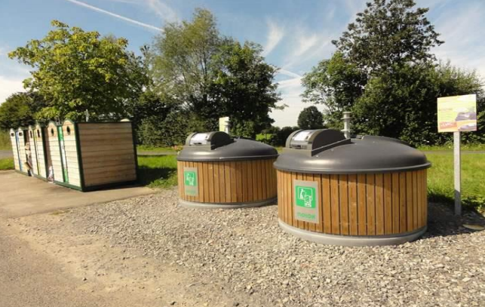
<< BACK
Exemple
In Barcelona : Operate CityOS, through a public-private partnership. Barcelona’s operating system, CityOS provides a shared environment for connecting to or using the city’s data. The recovery of urban data will enable Barcelona to grow by developing new services.
Smart Cities
Opportunity of Smart PPP
Providing access to technology
PPP allows implementation , fine- tuning ,improvement and ability to stay up to date to municipalities in their digital strategy
PPP legal framework has to be adapt to allow this deployment especially:
  Draft specification to allow technical innovation
  Speed – to avoid obsolescence at launch
  Allow inter-connection of interface and system – example connecting waste data and traffic data and security …
Cities need Private
Parties for Development
And operations.
In Singapore :
WaterGoWhere uses smart meters to keep residents updated on your water usage. Enabling reduction of loss at the user.
SUEZ’s AQUADVANCED® Urban Drainage in tropical environments To ensure maximum rainwater storage while preventing urban flooding with End to end water quality monitoring for a safe resource and a pleasant city
In France : Just in time collection with connect bin to Optimize waste collection thanks to effective data management ,Reduce CO2 emissions ,Reduce maintenance and servicing costs: zero overflow

Slide 16

07
SUEZ, a Group committed
to people and the planet

Slide 17

03
Back Up Slides

Slide 18
Thailand Legal Framework PISA Act 2013
Process and Step for PPP Approval
Project proposed by SOE (*)
Approval of the project proposal
Preparation of draft bidding documents by the host agency
Public selection process
Approval from Respon²sible Minister
Cabinet approval
2
3
4
5
1
Feasibility Study conducted by an independent external consultant (compulsory)
Both qualitative and quantitative assessments
Approval from Affiliated Ministry, SEPO and PPP Committee
Draft invitation to tender, draft TOR and draft PPP contract
Appointment of selection committee by the host agency
Transparent bid requirements
Transparent evaluation criteria
Nomination of preferred private bidder through the following process:
Issuance of Notice of Invitation
Announce shortlisted candidates
RFP
SEPO and Attorney General approve of Preferred Bidder and PPP contract
Review by respon²sible Minister and submission to the Cabinet for consideration
Enforcement of « security bond »
Signing of PPP contract and financial close
Completed project file submitted to SEPO 30days after signing
Appointement of a Supervisory Committee
150 days
  Minister: 60d
  SEPO: 30d (if no revision)
  PPP Committee: 60d (if deadline note met: implicit approval)
Process of revision between Minister, SEPO, host agency & Committee is clearly defined
SEPO and Attorney General: 45 days
Responsible Minister: 30 days
Notes:
Ferdinand de Lesseps was revolutionary.
Our first project was a PPP it started will but

Slide 19
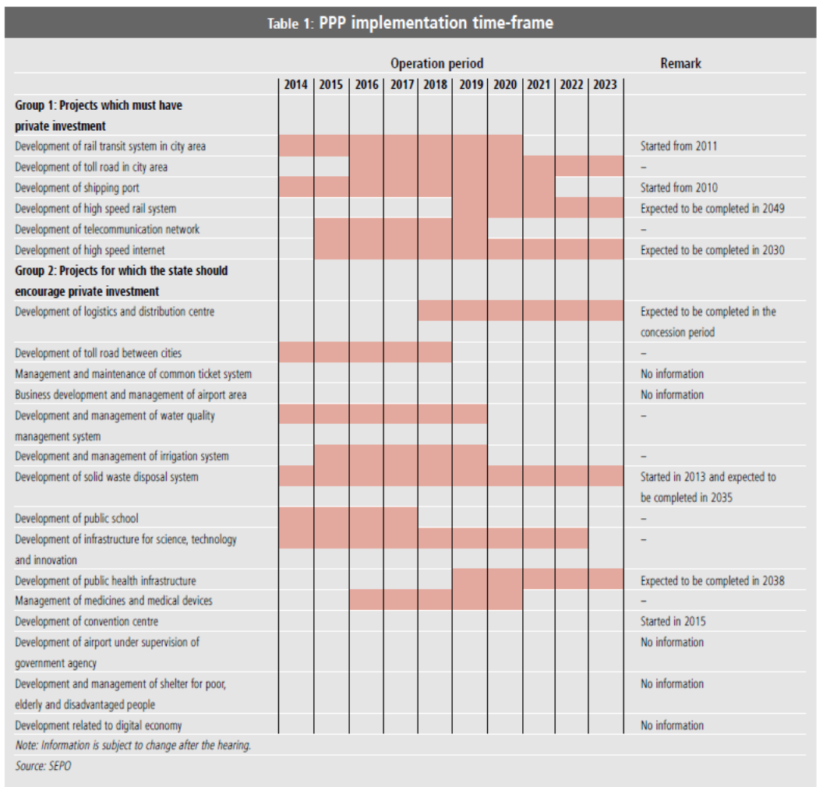
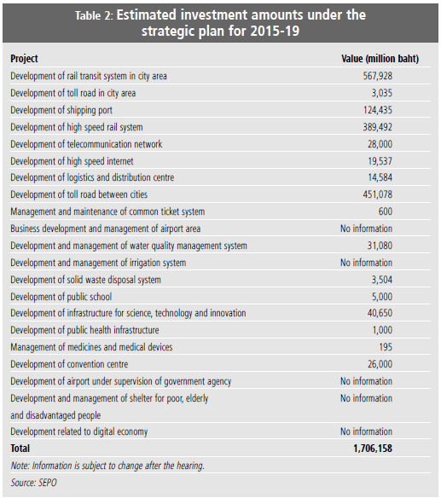
PPP 5-Year Plan ( 2015-2020)
SUEZ,
Notes:
On that list 3 WTE Project – none of them have happen or are close to happen

Slide 20
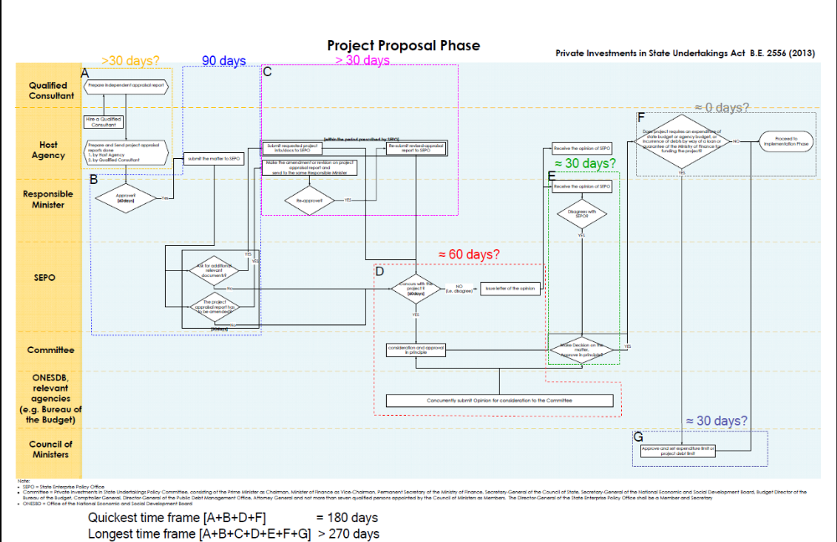
Thailand Legal Framework PISA Act 2013
Process and Step for PPP Approval
Notes:
Done with my team . No local are able to follow
Good for national project – difficult for loca;

Slide 21
  The Design-Build-Operate (DBO) is a contract where the Private Partner provide assets and on-going operation and maintenance services in respect of the assets.
  But the Public Partner pays for the asset on completion and for services when provided.
Client’s scope of work | Contractor’s scope of work
Legal ownership and regulatory responsibilities | Design & Construction (performance based)
Project finance for new or existing works | Operation (performance based)
Setting and collecting tariffs | Provision of staff (+ transfer of existing staff)
 | Managing renewals and finance (depending on contract duration and client’s requirement)
DBO
SUEZ,
Design Built operate
Characteristics:
Contract of results seeking for performance
Construction part pre-dominant on short term DBO and balanced on long term DBO
CAPEX owned by Client
Operator’s investment responsibility limited to renewal as defined in the contract depending on duration and client’s will
Design, Performance and O&M risks are transferred to DBO contractor
Duration : 2 to 30 years
Opportunity for some transfer of technology and good practices in long term DBO only
Long term DBO appropriate for client willing to build and operate an infrastructure with performance objectives and able to finance the investment
Short term DBO appropriate for clients willing to build an infrastructure and train its operators

Slide 22
  The BOT for Build-Operate-Transfer (also BOOT for Build-Operate-Own-Transfer) is a form of a public partnership for the development of treatment facilities (transfer stations/sorting and recycling centres/ EfW plants).
  The private Party takes the responsibility for the “Financing”, “Design”, ”Construction” and “Operation& Maintenance” of the facilities during the term of the BOT contract”
  The project is often developed by a Single Purpose Company(SPC) specially incorporated for this purpose (design, construction, financing and O&M)
  The SPC has the possession of the assets during the term of the contract and hand them back to the Client (Public Authority) at the end of the contract duration
Characteristics:
Contract seeking for performance & results
Construction and operation risks transferred to Operator = high risk transfer (integrated risk management)
Payment for investment and operations over whole contract life, which must be long enough to enable asset amortization (20 to 30 years)
Operation by field experts => guarantee for financiers (particularly when non recourse financing)
Single Client – Single Contractor => Single Contract
Particularly suited for new infrastructure entrusted by Public Sector
BOT
SUEZ,
Build Own-Operate Transfer
STRENGTHS | WEAKNESSES
Private operator has full control of the operations and investments. High turn-over and income for the Operator with long-term partnership. Socio-economical role of the Operator who becomes a major player in the country. Ability to generate side business or spot new opportunities Off-balance sheet financing; leverage effect. | Bid costs considerably higher. High degree of risk transferred to private operator. Capital-intensive business model. Capital-intensive model Client insolvency and affordability risk

Slide 23
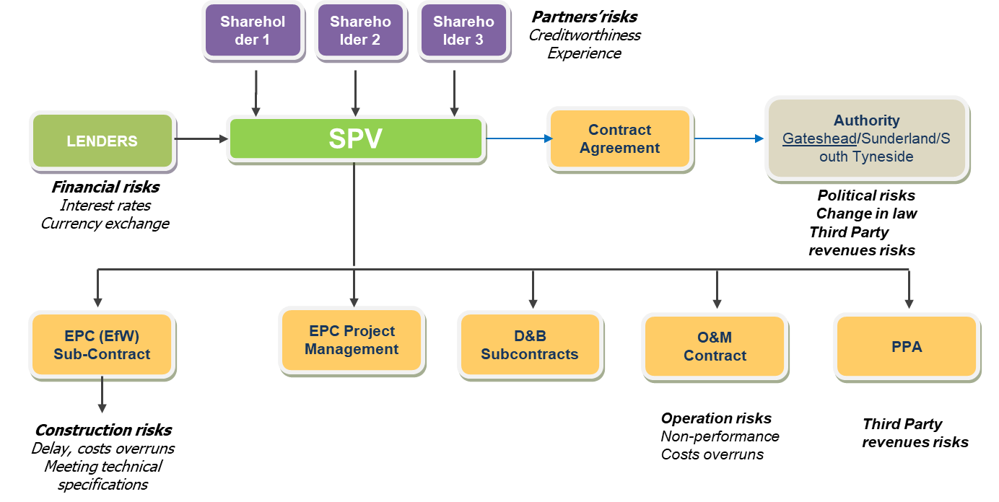
A Lawyer’s dream
BOT
SUEZ,
Typical Structure

