Slide 1

ASEAN Summit:
Public-Private Partnership
Public – Private Partnership in Energy Sector
Mr. Wattanapong Kurowat
Deputy Director-General
Energy Policy and Planning Office
4th April 2017

Slide 2
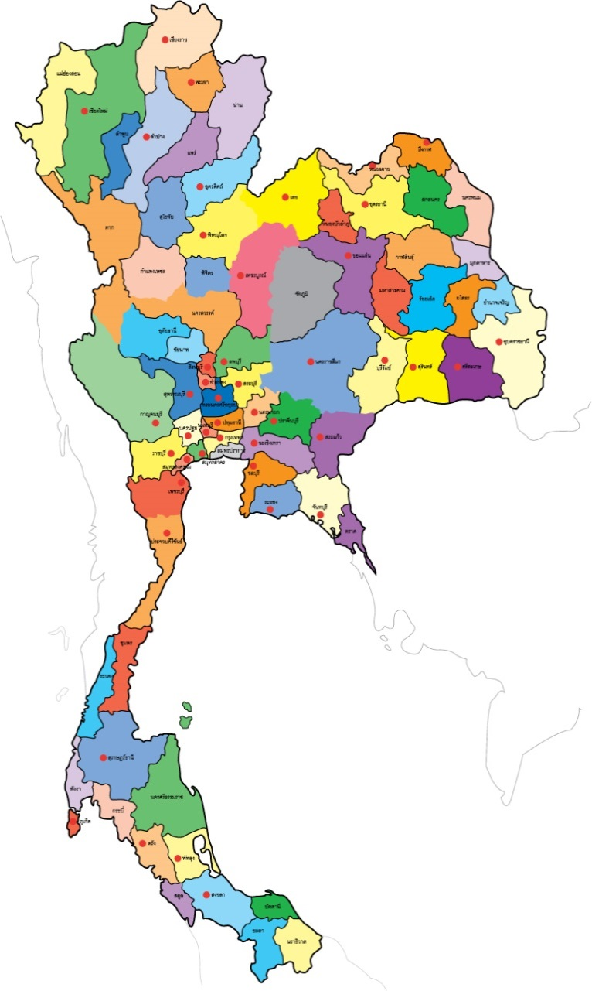
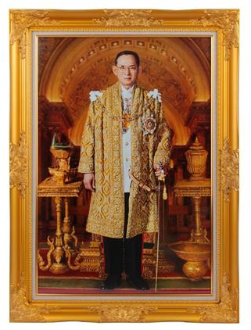
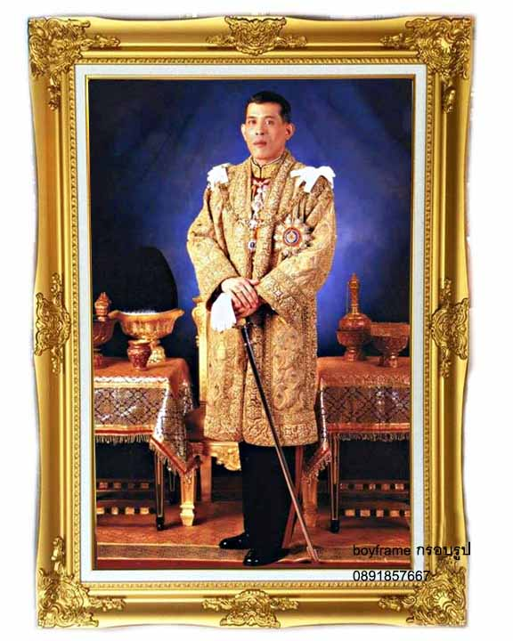

Thailand at a glance…
■ Capital City : Bangkok
GDP 2016
GDP : 272.5 Billion
US Dollars
Billion USD
■ Key Exports: Electronic
and Agriculture Goods
■ Economic Drivers : Tourisms
and Investment of Government
Electricity Demand :
182,849 GWh
2

Slide 3


Energy Landscape
7 Refineries Capacity : 1,234 KBD
Material Intake : 1,096 KBD
23% of State-Owned Refining Capacity
Condensate
Petroleum Product Markets
Domestic Supply
22%
Crude Oil
Refineries
Domestic Consumption
: 860 KBD
Import
78%
End Customers
Natural Gas
Domestic Supply
63%
Coal/Lignite
Natural Gas 47%
40% of State-Owned Power Plants
Renewable Energy
Power Plants
Natural Gas 16%
Hydro
2%
Renew 6%
Coal/
Lignite
8%
Power Market
Hydro
Electricity
Import
10%
Coal/
Lignite
11%
Import
37%
Electricity
Import
Install Capacity : 41,556 MW
3

Slide 4
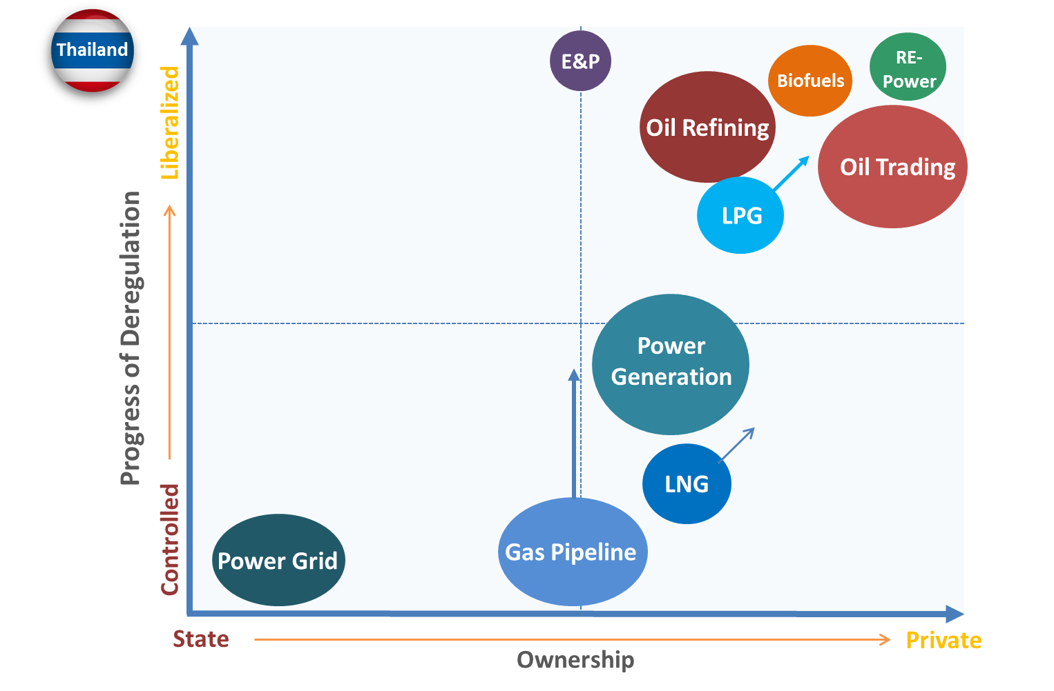
Public – Private Partnership in Energy Sectors
4

Slide 5
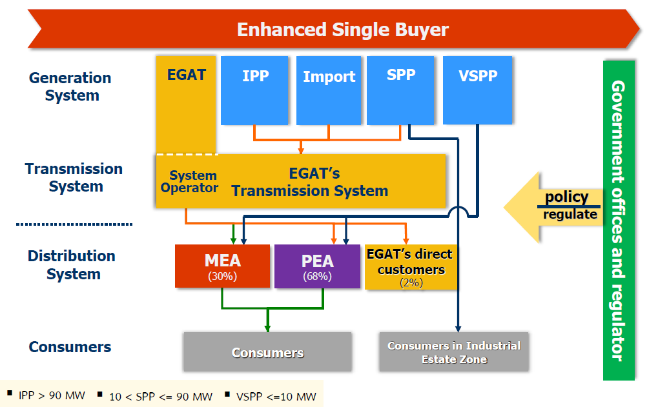


Electricity Supply Industry (ESI)
ERC
Policy
Regulate
5

Slide 6



Future Trends
CLEAN DISRUPTION
WHY CONVENTIONAL ENERGY AND
TRNAPORTATION WILL BE OBSOLETE BY 2030
Solar at/below grid parity in
up to 80% markets globally TODAY
The Solar Disruption
6

Slide 7
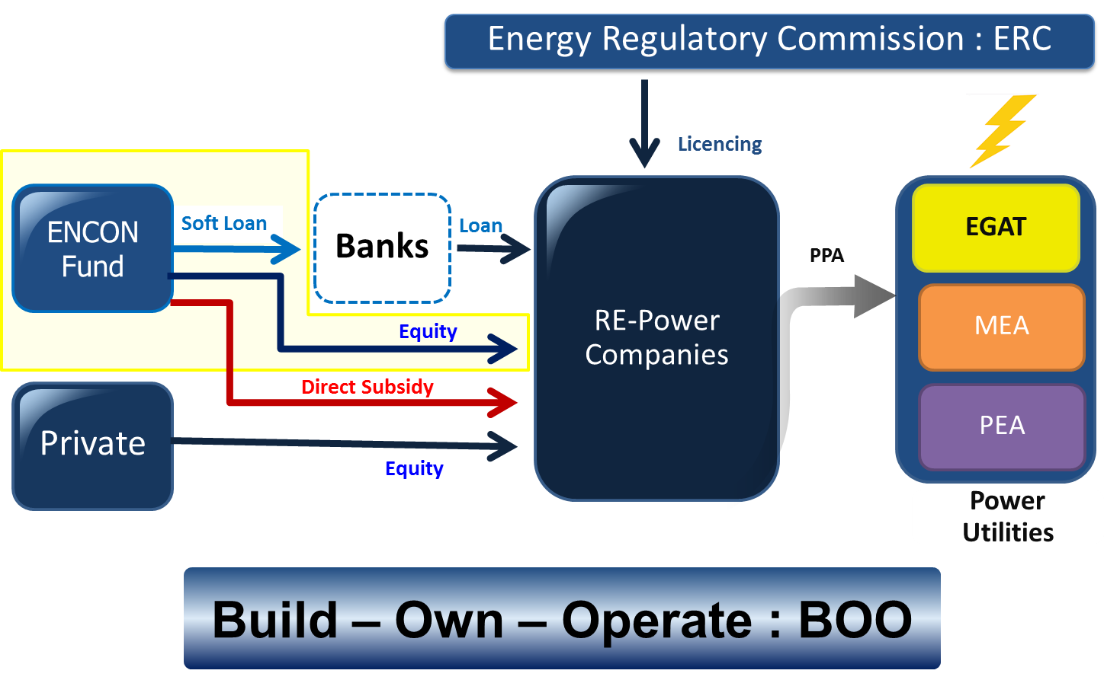
Energy conservation Fund
7

Slide 8
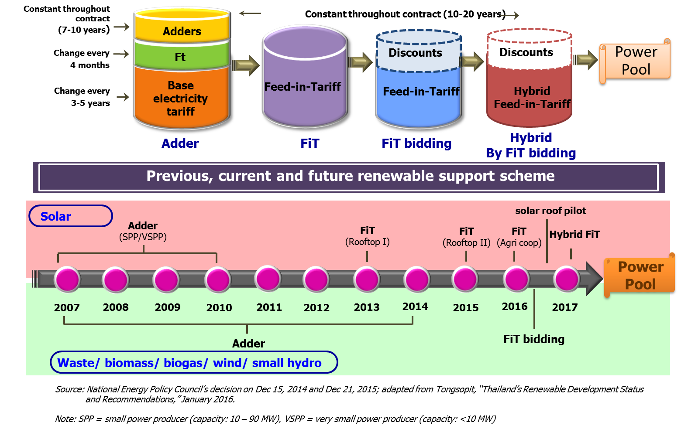
Renewable Support Scheme
8

Slide 9
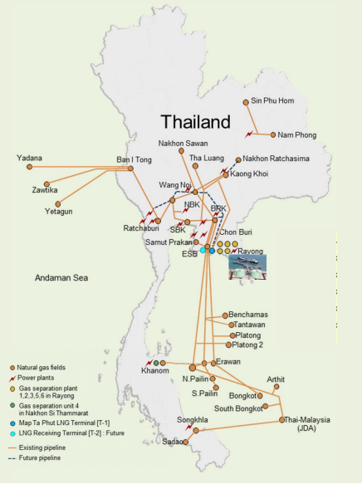
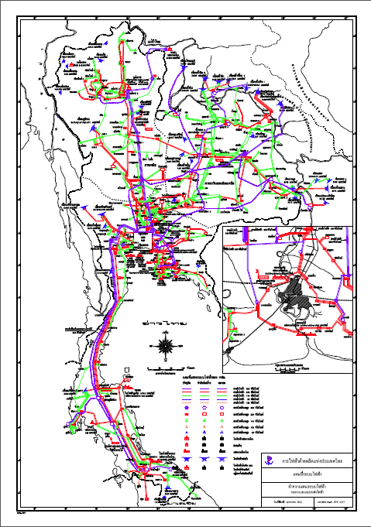
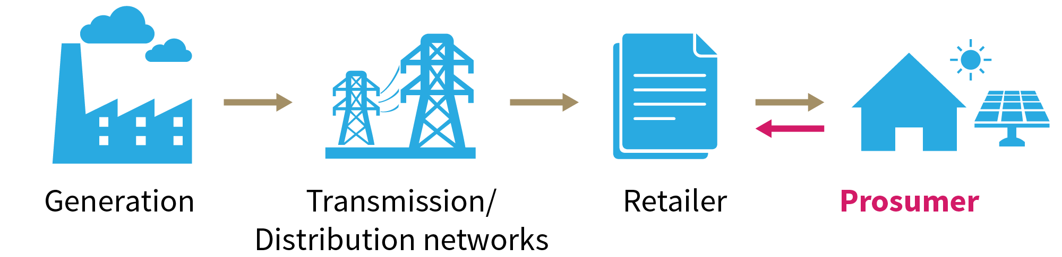
Gas&Power Liberalization
Gas Liberalization
Power Liberalization
  TPA Code
  Regulation
  TSO
  LNG Shipper
  Grid Code
  Private PPA &TPA
  TPA Code
  Regulation
  TSO
  LNG Shipper
9

Slide 10


Conclusion
Various of public-private partnerships (PPPs) project in energy sector has been implemented in Thailand for last two decades
FiT & Encon Fund play key role to support RE power PPP Project
Disruption Technology accelerate promotion of private investment in the near future
Gas & Power Liberalization is need to support change
PPP support development of infrastructure constructions and various other forms of public services & maximising state resources
10

Slide 11


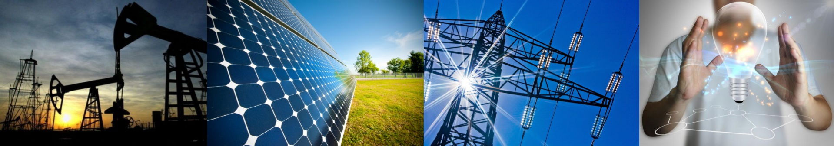
- Thank you - www.eppo.go.th

