Slide 1
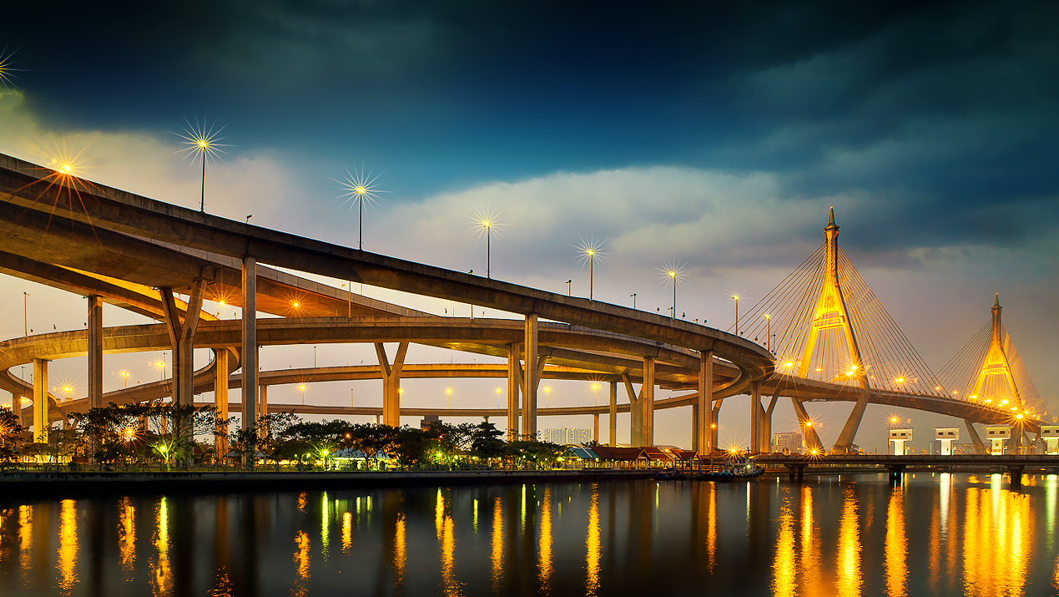

Public Private Partnership Summit
Arkhom Termpittayapaisith
Minister of Transport
April 4th , 2018

Slide 2
Content
Financing for Infrastructure
Action Plan (2016-2018)
Thailand’s Transport Infrastructure Development 2015-2022
PPP in Thailand
Projects under PPP Fast Track

Slide 3
Plans under Thailand’s Transport Infrastructure Development Strategies 2015-2022
Plan 1: Intercity Rail Networks Development
Plan 2: Improving
Public Transport Networks & Services
Plan 3: Enhancing
Connectivity between
Key Domestic Production Bases & Neighboring Countries
Plan 4: Increasing Water Transport Network
Plan 5: Enhancing Air Transport Capability
1.1 Tracking & Facilities Improvement
2.1 Implementation of 10 Metro Lines
4.1 Inland Port Development
5.1 Airport Capacity Expansion
3.1 Accessibility to Agricultural & Tourist Areas
4.2 Coastal Port Development
2.2 Construction of Roads & Bridges
5.2 Enhancement
in Air Traffic Management Capability
1.2 Dual Track Development
3.2 Connectivity between Hub & Key Production Bases
2.3 Procurement of 3,183 NGV Buses and Depots
5.3 Increased Fleet Utilization
3.3 Connectivity between Gateways
ฮ
5.4 Air Transport Industrial Park
3.4 Promoting Seamless Multi-Modal Transport
5.5 Human Resource Development

Slide 4
Source of Financing
Source of Financing
Government Budget
Loans
SOE Revenue
Others
Infrastructure Fund
PPPs
Cabinet acknowledged
March 27, 2015
Others : Under consideration for Source of Financing

Slide 5
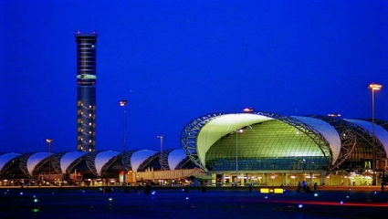
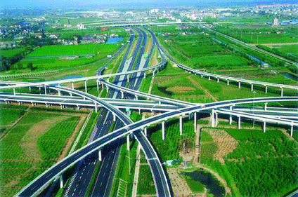
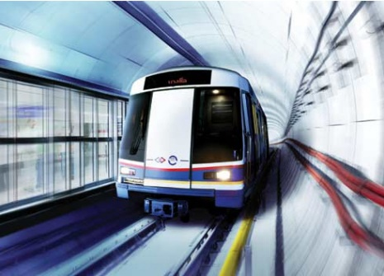
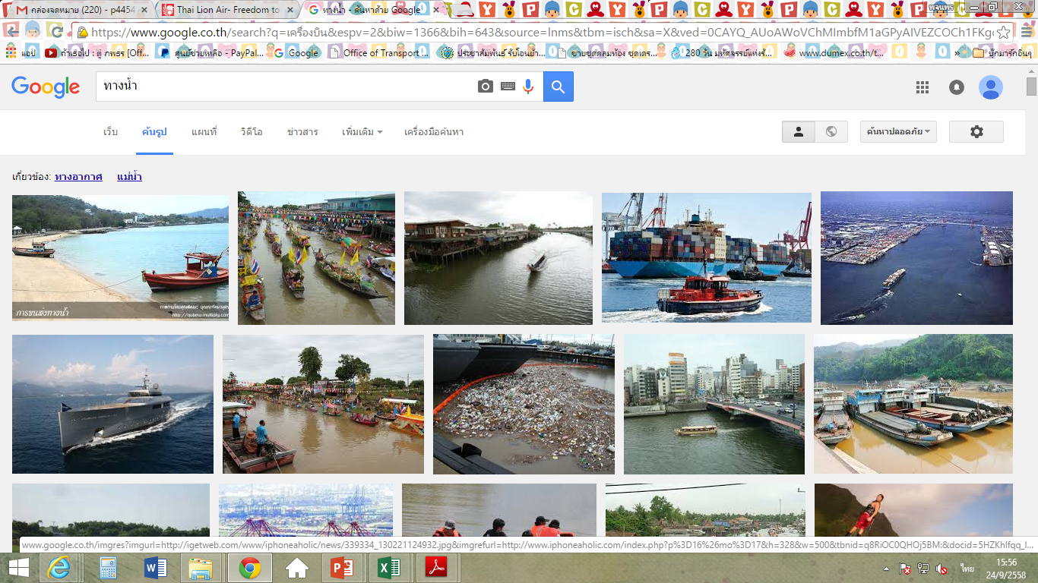
Action Plan 2016 (20 Projects) Investment Cost 51,325.31 US M.
1. Air Transport
 | Suvarnabhumi Airport Phase II (1,437.78 US M.)
Cabinet acknowledged
December 1, 2015
Urban Mass Rapid Transit
1) Orange Line: Thailand Cultural Ctr-Minburi (3,259.93 US M.)
2) Pink Line: Kae Rai-Minburi (1,528.16 US M.)
3) Yellow Line: Lad Praow - Sam Rong (1,408.19 US M.)
4) Red Line: Bang Sue-Phyathai-Makkasan- Hua Mak & Bang Sue-Hua Lam Phong (1,261.65 US M.)
5) Purple Line: Tao Poon-Ratburana (2,888.91 US M.)
Dual Track Railways (1.00 Meter-gauge)
 | 1) Jira Junction – Khon Kaen (680.07 US M.)
 | 2) Mab Kabao- Jira Junction (841.38 US M.)
 | 3) Nakhon Pathom -Hua Hin (572.75 US M.)
 | 4) Prachuab Kiirikan- Chumpon (492.85 US M.)
 | 5) Lop Buri- Pak Nam Pho (706.35 US M.)
Motorway
Pattaya-Mab Taphut (509.13 US M.)
2) Bang Pa In- Saraburi-Nakhon Ratchasima (2,089.51 US M.)
3) Bang Yai-Ban Pong-Kanchanaburi (1,340.60 US M.)
Standard-gauge, Dual-Track Railways
1) Bangkok- Nong Khai, Kaeng Koi-Mab Taphut (10,547.08 US M.)
2) Bangkok- Phitsanulok-Chiang Mai (12,842.08 US M.)
3) Bangkok-Hua Hin (2,704.94 US M.)
4) Bangkok-Ra Yong (4,357.94 US M.)
Maritime Transport
1) | Coastal port development (Terminal A), Laem Chabang Port (48.72 US M.)
2) | Single Rail Transfer Operator (SRTO) Phase 1, Laem Chabang Port (52.02 US M.)

Slide 6






Action Plan 2017 (36 Projects) Investment Cost 25,593.07 US M.
In Service: 2 projects
Ferry Service across Gulf of Thailand (MD)
Common ticket system (OTP)
38.72 US M.
- US M.
38.72 US M.
Cabinet acknowledged
December 13, 2016
Procurement Stage: 15 projects
Public Bus Procurement & Station (BMTA)
Blue Line : Bang Kae – Sai 4 (MRT)
Dark Green : Samutprakarn – Bang Pu (MRT)
Dark : Kukot - Lumluka (MRT)
Orange : Talingchan –Thailand Cultural Centre (MRT)
ARL Extension Don Muang-Bang Sue- Phayathai (SRT)
Dark Red : Rangsit – TU Rangsit (SRT)
Dual Track (DT) Paknampho-DenChai (SRT)
DT Jira - Ubonratchathani (SRT)
DT Khonkaen – Nong Khai (SRT)
DT Chumporn – Surat Thani (SRT)
DT Surat Thani - Songkha (SRT)
DT Hat Yai – Padang Beza (SRT)
DT Denchai – Chiang Mai (SRT)
MRO Dev. at U – Tapao Airport (TG)
13,387.56 US M.
64.92 US M.
605.63 US M.
347.03 US M.
280.09 US M.
3,524.40 US M.
889.98 US M.
217.06 US M.
1,601.89 US M.
1,023.99 US M.
744.74 US M.
668.14 US M.
1,480.67 US M.
226.91 US M.
1,712.12 US M.
- US M.
Construction Stage: 5 projects
Intermodal Facility – Chiang Khong (DLT)
Regional Airport Dev. (Mae Sot/Bae Tong/Sakon Nakhon/Krabi) (DOA)
Rama 3 – Dao Kanong-Outer Ring (West) (EXAT)
DT Hua Hin- Prachuap Khiri Khan (SRT)
Baggage System Handling Upgrade at Suvarnabhumi Airport (AOT )
1,565.67 US M.
67.59 US M.
219.59 US M.
892.69 US M.
292.56 US M.
93.25 US M.
Cabinet/PPP Committee Approval: 8 projects
New Line DT Den Chai-Chiang Rai-Chiang Khong (SRT)
New Line DT Ban Pai – Nakhon Phanom (SRT)
Light Red Extension : Taling Chan-Siriraj & Taling Chan-Saraya (SRT)
Lam Cha Bang Phase 3 (PAT)
Exp. Northern Route N₂ and E-W Corridor (CAAT)
Exp. Kratu – Patong (EXAT)
Motorway Nakhon Phatom – Cha Am (DOH)
Cross-border Logistics Center Nakorn Phanom (DLT)
8,514.42 US M.
2,199.39 US M.
1,724.34 US M.
544.06 US M.
1,002.84 US M.
410.91 US M.
299.90 US M.
2,302.86 US M.
30.10 US M.
Proposal Development: 4 projects
Ferry Terminal Dev. (MD)
Motorway Hat Yai-TH-Malaysia Border (DOH)
Regional Truck Terminal (9 border provinces ) (DLT)
Regional Truck Terminal (8 regional cities) (DLT)
1,399.59 US M.
28.05 US M.
871.43 US M.
230.45 US M.
269.66 US M.
Policy Driven: 2 projects
1. Truck Rest Area (Buriram/Udonthani/Kampaeng Phet) (DOH)
2. Mass Transit in Phuket (MRT)
687.11 US M.
15.71 US M.
671.40 US M.

Slide 7


Action Plan 2018 (44 Projects) Total Investment 57,750.96 US M.
Target within Fiscal year 2018
21 Projects Cabinet/ PPP Committee Approval
23 Projects Procurement/Construction/In Service
397.62
32.36
230.00
238.35
11.91
49.60
2,223.80
973.43
716.30
1,145.00
7,892.17
2,225.91
1,432.50
3,663.86
861.56
3,063.8
388.37
398.50
2.59
52.17
114.90
Expressway: Kratu-Patong (EXAT)
Cross-Border Logistics Centre at Nakorn Phanom (DLT)
Regional Truck Terminal (9 Border provinces) (DLT)
Regional Truck Terminal (9 Regional cities) (DLT)
Bus Procurement (EV) (BMTA)
Bus Procurement (NGV) (BMTA)
Motorway: Nakhon Phatom-Cha Am (DOH)
Motorway: Hat Yai-TH-Malaysia Border (DOH)
Motorway: Rangsit-Bang Pa-In New (DOH)
Motorway: H35 BKK-Maha Chai New (DOH)
HSR BKK-Chiang Mai (OTP/SRT)
HSR BKK-Hua Hin (OTP/SRT)
Red Line: Bang Sue – Phayathai – Makkasan - Hua Mak & Bang Sue - Hua Lam Phong (SRT)
Purple Line: Tao Poon-Ratburana (SRT)
Mass Transit in Phuket (OTP/SRT)
Mass Transit in Chiang Mai New (OTP/SRT)
Mass Transit in Nakhorn Ratchasima New (OTP/SRT)
Mass Transit in Khon Kean New (OTP/SRT)
Laem Chabang Phase 3 (PAT)
Dry Port New (PAT)
MRO (TG)
13.71
892.70
501.46
1,226.67
647.94
882.30
1,789.00
1,072.00
761.55
694.00
1,639.12
231.90
1,711.86
2,438.43
1,941.86
5,126.06
5,811.35
187.73
504.9
3,441.68
34.73
64.28
21.07
Truck Rest Area Buriram/Khon Kean (DOH)
Expressway: Rama 3-Dao Kanong-Outer Ring Road (EXAT)
Northern Route N₂ and E-W Corridor (EXAT)
DT Nakhon Pathom-Chumpon (SRT)
DT Lop Buri-Pak Nam Pho (SRT)
DT Mab Kabao-Jira Junction (SRT)
DT Paknampho-Denchai (SRT)
DT Jira-Ubonratchathani (SRT)
DT Khon Kean-Nong Khai (SRT)
DT Chumporn-Surat Thani (SRT)
DT Surat Thani-Song Khla (SRT)
DT Hat Yai-Padang Besar (SRT)
DT Den Chai-Chiang Mai (SRT)
New DT Den Chai-Chiang Rai-Chiang Khong (SRT)
New DT Ban Pai-Nakhon Phanom (SRT)
HSR BKK-Nakhon Ratchasima (OTP/SRT)
HSR Connection to 3 Major Airports (Donmuang – Suvarnabhumi – U - Tapao) (SRT)
Dark Red Rangsit-TU Rangsit (SRT)
Light Red Extension Sirirat-Taling Chan-Salaya (SRT)
Orange Line : Western Section (SRT)
Dev. Krabi Airport (Apron) New (DOA)
Dev. Khon Kean (Passenger terminal) New (DOA)
Common Ticket (SRT/OTP)
Total 26,114.64 US M.
Total 31,636.32 US M.
Note : Orange - Action Plan 2016 10 projects Black - Action Plan 2017 : 32 projects Blue – New 8 projects

Slide 8

Source of Fund
PPP
20.98%
PPP
22.05%
PPP
24.85%
 | Action Plan 2016 |  | Action Plan 2017 |  | Action Plan 2018
Source of Fund | US Dollar (Million) | % | US Dollar (Million) | % | US Dollar (Million) | %
Borrowing | 36,163.66 | 70.46 | 16,454.36 | 64.29 | 26,805.95 | 46.42
PPP | 10,768.28 | 20.98 | 5,642.62 | 22.05 | 14,350.72 | 24.85
Budget | 2,401.86 | 4.68 | 2,118.14 | 8.28 | 3,340.45 | 5.78
SOE's Revenue | 1,585.79 | 3.09 | 97.40 | 0.38 | 26.30 | 0.05
Revolving Fund | 405.71 | 0.79 | - | - | - | -
TFF | - | - | 1,280.54 | 5.00 | 1,371.08 | 2.37
N/A | - | - | - | - | 11,856.46 | 20.53
Total | 51,325.31 | 100 | 25,593.07 | 100 | 57,750.96 | 100
N/A : Under consideration for Source of Financing

Slide 9
Financing for Infrastructure
Financing Source by Sector: 2015 - 2022
Source/ Sector | Metropolitan Mass Transit | Railway | Highways/ Waterway | Motorway | Air Transport
Government Budget | - Land acquisition - Consultation | - Land acquisition - Consultation | - Land acquisition - Consultation - Civil works | - Land acquisition - Consultation | - Land acquisition - Consultation - Civil works
Government Borrowing | - Civil works | - Civil works - Signaling System | - Civil works (Mega Projects) | - Civil works
SOE Revenue/Loans
PPPs |  |  |  | - Toll collection system
Infrastructure Funds |  |  |  | - Maintenance works
- Rolling Stock
- Rolling Stock
Notes:
In relation to funding transport infrastructure projects over the next 8 yrs.
Related agencies such as Budget Bureau, NESDB, MOF and MOT has been working on funding for transport infrastructure projects.
The committee has agreed on the framework that:
-Annual budget will allocate for land acquisition/ consultation/ civil works for non-mega projects
- While government borrowing will fund for civil works, signaling system and mechanics and equipments of mega projects
-State enterprise revenue/loans and PPPs will finance for rolling stock of Metropolitan Mass Transit and railway
-While infrastructure funds will finance rolling stock for metro mass transit, PPP & Infrastructure Fund will fund for toll collection systems, maintenance works and network extension

Slide 10
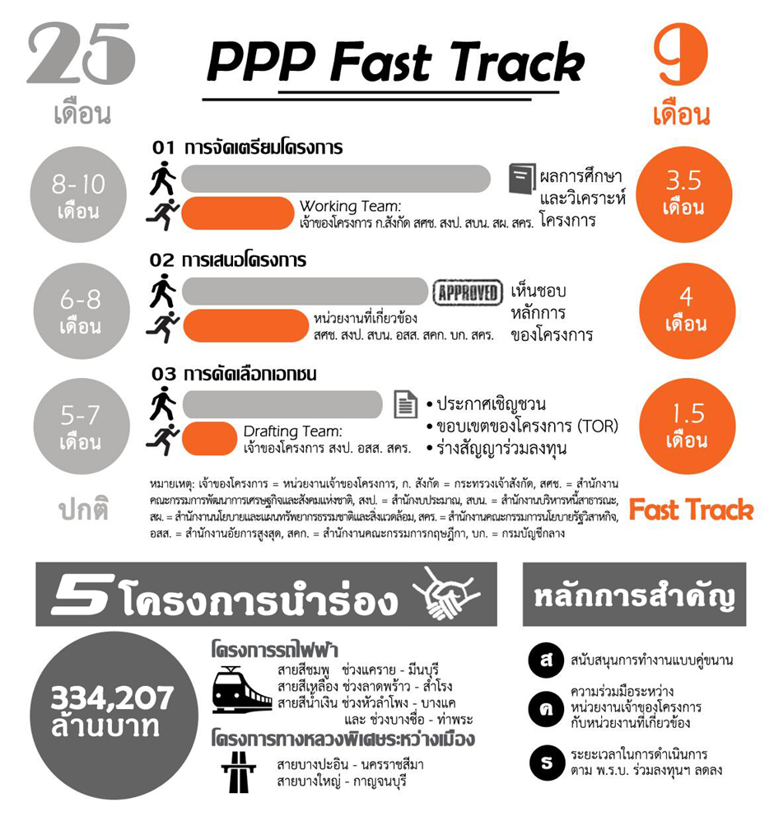
PPP Fast Track
25
Months
9
Months
8-10
Months
01 Project Preparation
3.5
Months
Project
Proposal
Completed
Working Team:
PO, LM, NESDB, BB, PDMO, ONEP, SEPO
6-8
Months
02 Project Proposal
4
Months
Project
Proposal
Approved
Relevant Agencies:
NESDB, BB, PDMA, AGO, OCS, CGD, SEPO
5-7
Months
03 Private Selection
1.5
Months
Invitation to tender
for Private Investment
Term of Reference
Draft contract
Drafting Team:
NESDB, PO, BB, AGO, SEPO
Note: PO = Project Owner, LM = Line Ministry, NESDB = Office of the National Economic and Social Development Board, BB = Bureau of the Budget, PDMO = Public Debt Management Office, ONEP = Office of Natural Resources and Environment Policy and Planning, SEPO = State Enterprise Policy Office, AGO = Office of the Attorney General , OCS = Office of the Council of State, CGD = The Comptroller General’s Department
Source: State Enterprise Policy Office, Thailand
Fast Track

Slide 11




Transport Projects under PPP Fast Track
Intercity Motorways
Mass Rapid Transit Projects
1. Pattaya – Map Ta Put
2. Bang Pa In – Saraburi – Nakhon Ratchasima
3. Bang Yai – Ban Pong - Kanchanaburi
1. Pink Line (Khae Rai – Min Buri)
2. Yellow Line (Lat Phrao – Samrong)
3. Orange Line (Thailand Cultural Centre – Min Buri)
4. Sounthern Purple Line (Tao Poon – Ratburana)
5. Blue Line (Bang Kae Sai 4)
6. Dark Green (Samutprakran-Bang Pu)
7. Dark Green (Kukot - Lunluka)
8. Orange Line (West side)
High Speed Trains
1. Pattaya – Map Ta Put
2. Bang Pa In – Saraburi – Nakhon Ratchasima
3. Bang Yai – Ban Pong - Kanchanaburi

Slide 12
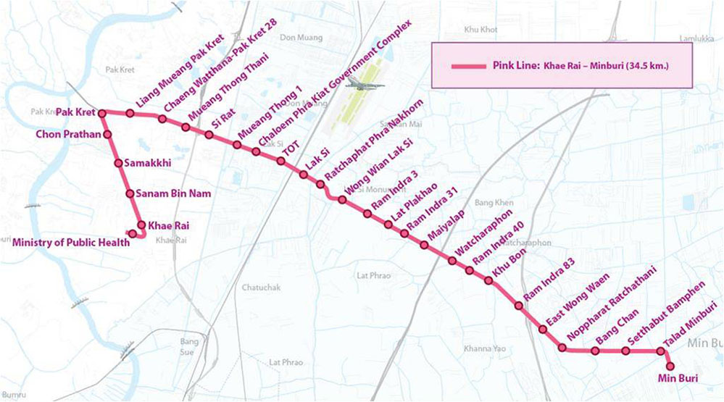
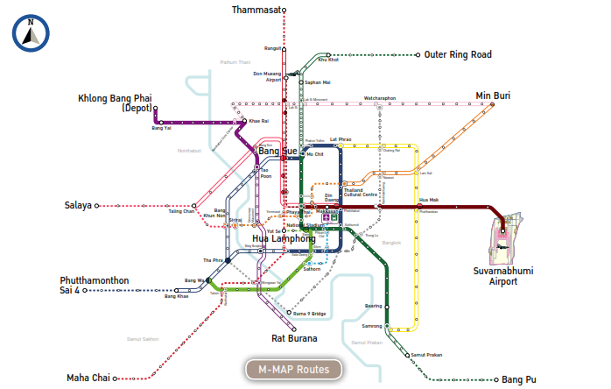
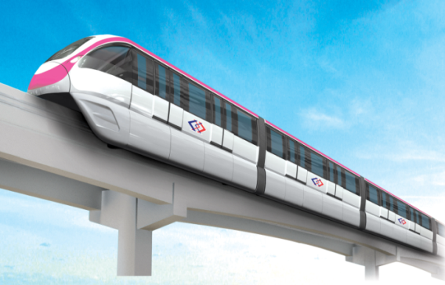
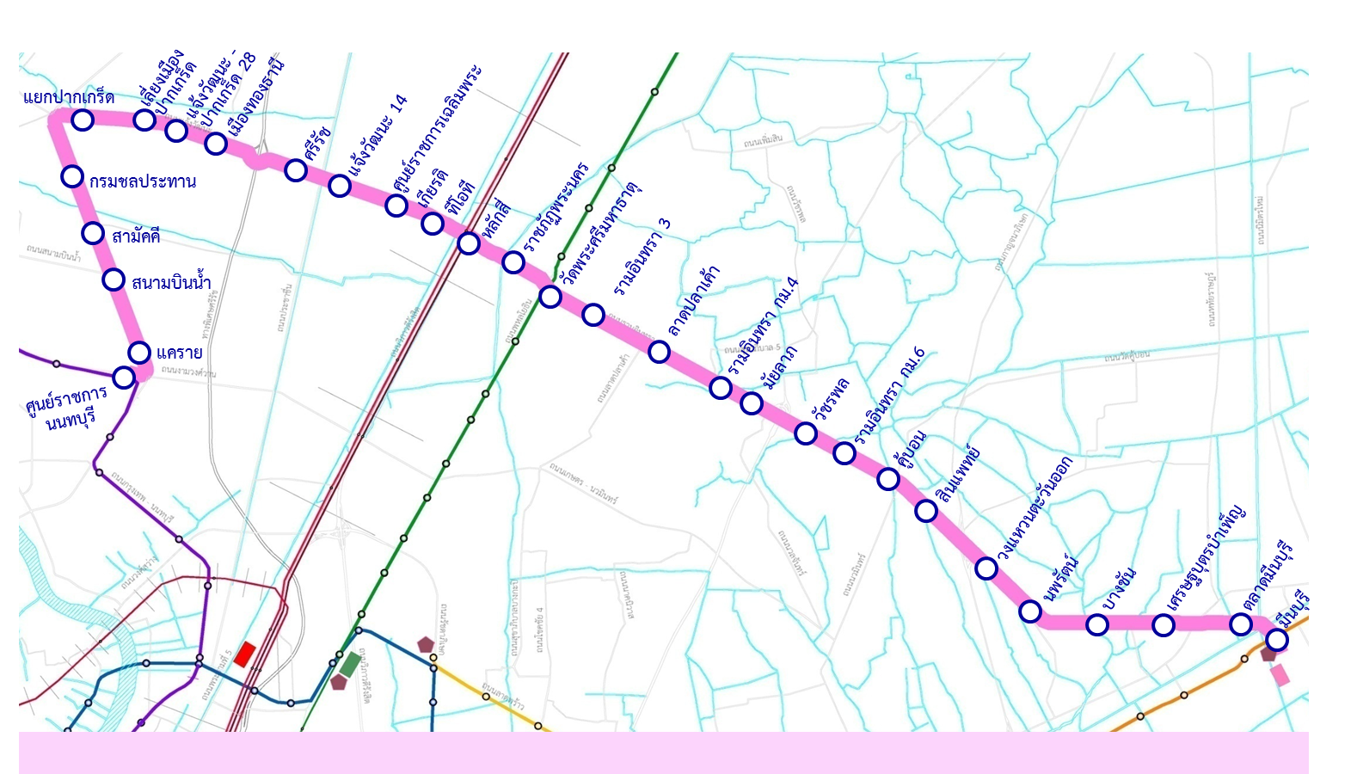
Pink Line (Khae Rai - Minburi )
Pink Line
Distance 34.5 km with 30 stations
Monorail System
PPP Fast Track
Awarded to BSR Joint Venture as PPP net cost
Current Status
May 30, 2016 Cabinet approved for PPP selection
Construction in 2018
Expected operation in 2020

Slide 13
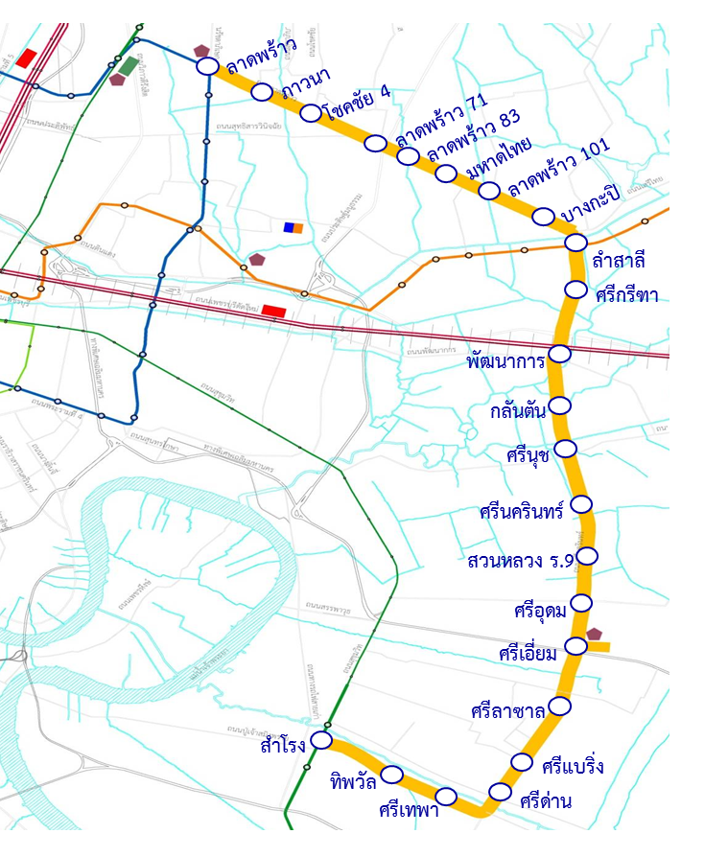
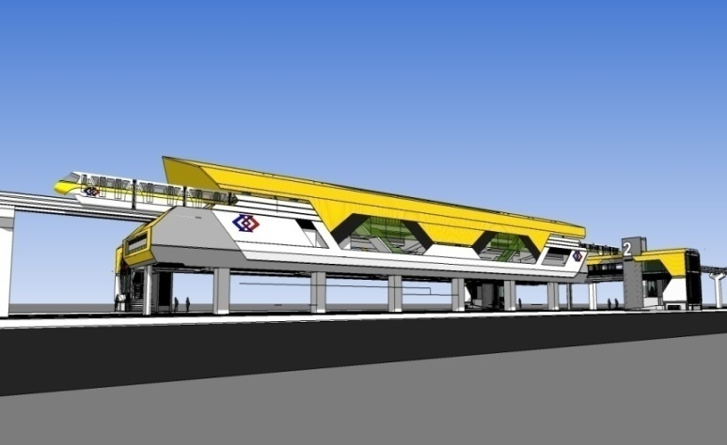
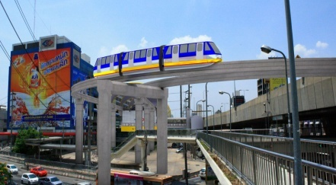
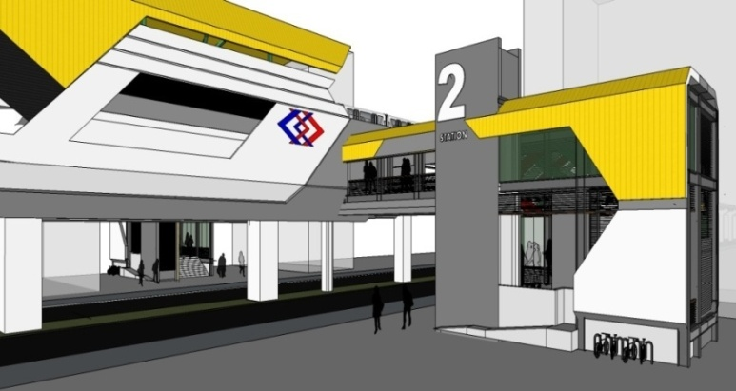
Yellow Line (Lat Prao - Samrong )
Yellow Line
Distance 30.4 km with 23 stations
Monorail System
PPP Fast Track
Awarded to BSR Joint Venture as PPP net cost
Current Status
May 30, 2016 Cabinet approved for PPP selection
Construction in 2018
Expected operation in 2020

Slide 14
Thank You

