Slide 1

Enterprise-level email and IT on an SME budget in Thailand
for
the ICT Business Mission to Thailand
prepared by
Eric Helander / RunTime Co., Ltd

Slide 2

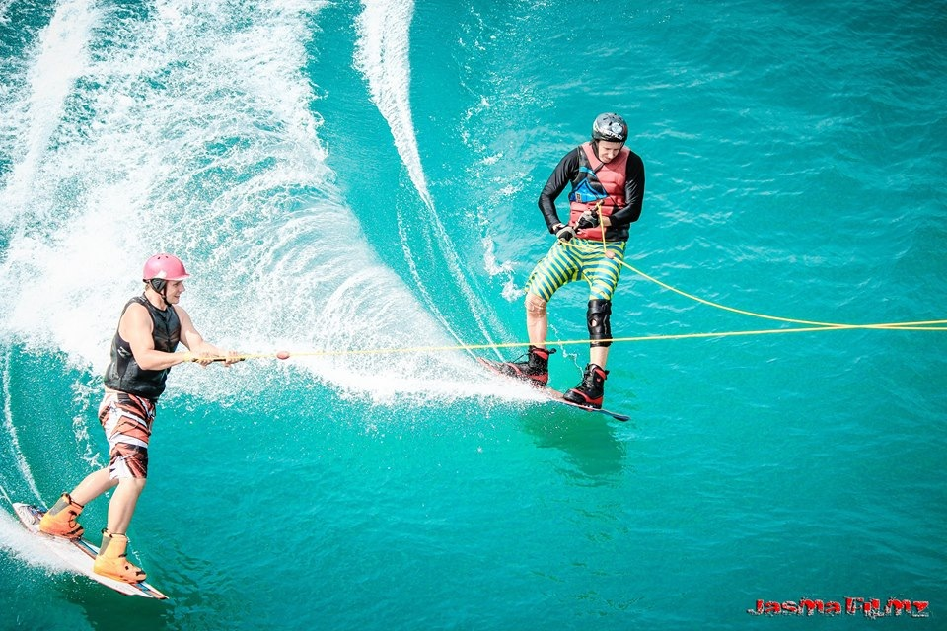
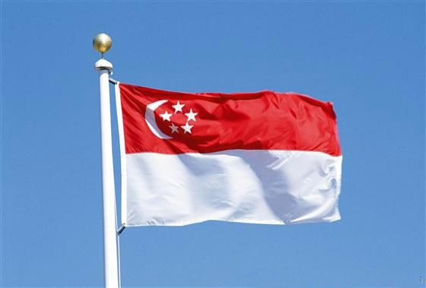
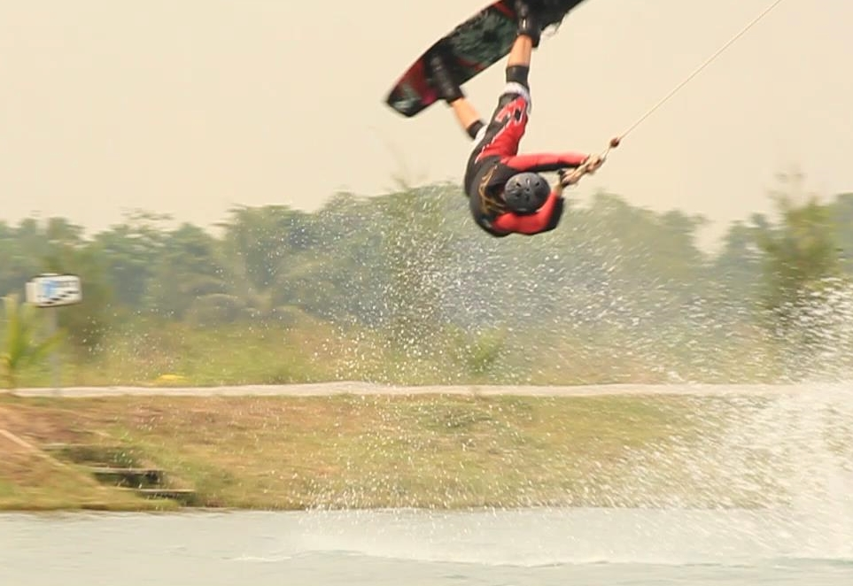
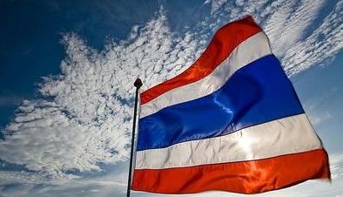
37 years old, from Sweden
MsC Comp.Eng
Nanyang Tech. University Singapore
14 years in Thailand

Slide 3
IT priorities when setting up shop in Thailand
Own your Internet domain name (MyCompany.com)
Control mobile devices that contain company information
Utilize Microsoft’s “Office 365” enterprise cloud-hosted email and storage
Backup your data (Cryptoware/viruses)
Be aware of the Computer Crimes Act of 2007 (revised 2016)
Privacy concerns

Slide 4
Most common SME IT questions
What is actually the cloud?
Is cloud access slow from Thailand?
How can we migrate (“onboarding”) to the cloud?
My Internet provider sold me a connection with a speed of a trillion megabits per second. How come it is still so slow?

