Slide 1

Doing Business In Thailand
What we learned

Slide 2


History & DNA
Founded in 2011
BOI Promoted Company
Planned to be an Offshore Company
  but…

Slide 3
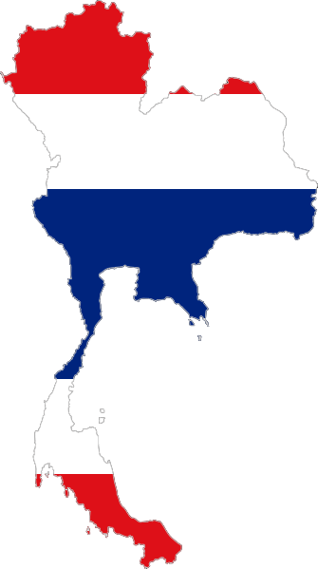
Doing business in Thailand
BOI and Process
VISA and Work permit
Business opportunities and channels
Thai and Foreign business targets

Slide 4



Company Vision & Marketplace
To provide proprietary solutions on different markets
Consultancy on bespoke software solutions
System integrators
Business partnerships and opportunities

Slide 5
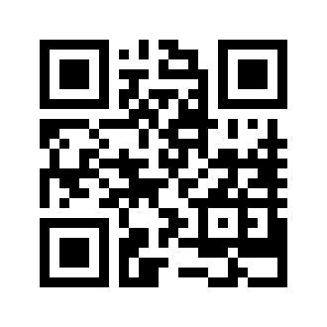
Contacts
Web: www.digithaigroup.com
Mail: info@digithaigroup.com
Tel: +66(0) 82 449 8762
(English/Italian)

